Slide 1
Setting up your machine
Download a copy of R on your local computer from the Comprehensive R Archive Network (CRAN). You can choose between binaries for Linux, Mac and Windows.
Install one of R’s integrated development environment (IDE), RStudio, which makes R coding much easier and faster as it allows you to type multiple lines of code, handle plots, install and maintain packages and navigate your programming environment much more productively.
Install all suggested packages or dependencies including GUI.
https://cran.r-project.org/doc/manuals/R-intro.pdf
Notes:
If you currently use another statistical package, why learn R?
It's free! If you are a teacher or a student, the benefits are obvious.
It runs on a variety of platforms including Windows, Unix and MacOS.
It provides an unparalleled platform for programming new statistical methods in an easy and straightforward manner.
It contains advanced statistical routines not yet available in other packages.
It has state-of-the-art graphics capabilities.

Slide 2
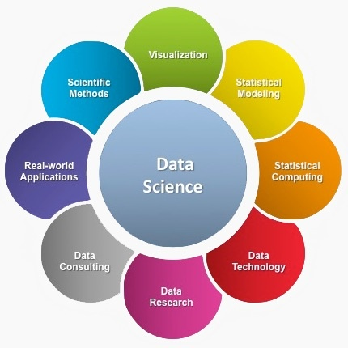

Introduction to Data Science in R
Participant’s Guide
August 31st, 2020 Team: Brian Ashford
Dewayne Dixon
Yvonne Phillips

Slide 3

About BeVera
Founded in 2013
HQ in Metro Atlanta
Veteran-Owned Small Business
Data Science Training and Consulting
Public Health and Technical Staffing
CDC Customers: CSELS, CGH, NCEH, NCEZID

Slide 4

BK Ashford, Director of Data Science
Over 22 years of Data Science solution delivery experience
Analytical Consultant for SAS Institute for over 11 years
Successful Data Science solution delivery across multiple industries
Insurance Carriers
Major Airlines
Credit Bureaus
Retail
Education:
M.Sc. Applied Mathematics, Lehigh University
B.S. Mathematics, Morehouse College

Slide 5
Yvonne Phillips, INSTRUCTOR
18 years of Predictive Analytics work
Currently Adjunct Professor, Morehouse College – Computer Science/Data Science
Experienced analytic professional with demonstrated history in:
Insurance: Underwriting Auto & Property, Motor Vehicle Reporting Analytics
Government: Federal and State/Local government customer solutions needs
Financial/Credit Cards
Retail
Education:
M.Sc., Decision Science, Georgia State University, Robinson College of Business
B.S., Mathematics, Spelman College

Slide 6

Dewayne Dixon, INSTRUCTOR
5 years of Educational Instruction in Mathematics
Currently Ph.D. student in Data Science and Machine Learning, Howard University
Skilled in:
Python/Pandas/Numpy/skilearn
JSON
SQL
NoSQL
Education:
M.Sc. Applied Mathematics, Virginia State University
B.S. Mathematics, Morehouse College

Slide 7
Learning OBJECTIVES: during these sessions, Our Data Science trainers will:
Describe the data science process and how it’s components interact
Define big data and know the challenges
Explain the significance of exploratory data analysis and data science
Relate data science techniques to common scenarios
Introduce attendees to machine learning techniques commonly used
Demonstrate basic data science techniques using the R programming language
Apply basic tools plots, graphs, some re-statistics to carry out EDA
Use are the carry out basic statistical modeling and analysis

Slide 8
Module 1: Big Data
Notes:
We use R to explore, analyze, and understand public health data.
Setting the context of what an analysis does with the data - Here to talk about R that has more to do with the analysis of data than engineering.
From our experience and talking with clients the picture of the lifecycle of a data science project
Disruption/Problem to solve – first step is to become familiar with the data at your disposal
After you have an idea of what you want to do then develop the solution of what you want to
Modeling – iteration, fine tuning - getting the solution as you want it.
If you are not the Then productize if you are not the one who - in a business pipeline automate or
Publish the model – if handing it off to a manager or whatnot
Then there are other things to help publish R
R works is a language and a full scripting language.
We analyze data straight out of tables provided in reports or articles
Full-function calculator
Extensible statistical package
High-quality graphics tool
Multi-use programming language
ell as analyze usual data sets.

Slide 9

“Big data is a collection of data from traditional and digital sources inside and outside your company that represents a source for ongoing discovery and analysis.” (Lisa Arthur, CMO Network, 8/15/2013). “Big Data” is data whose scale, diversity, and complexity require new architecture, new tools, techniques, algorithms, and analytics to manage it and extract value and hidden knowledge from it…
Notes:
Big Data is the data which cannot be managed by using traditional databases.
History of Big Data
Roger Magoulas, in 2005, coined the term ‘Big Data’. In the same year, the development of Hadoop started. It is an open-source framework that could process both structured and unstructured data.
R has a lot to offee for each stages – Base R, stat
Use the shiny package – a little data package
R markdown to publish in a very easy way
R is
Important to realize
Big data with R it is a language but not a piece of software designed to store data
A typical use case is loading data in R, while there R R will hold data in the RAM
Is there a data larger than our computer’s work. Ram on your computer
Assume you work > larger than your computers ram.
Before you work with the data you always have a smaller subsest to work with. If not the you may not be using big data
Scale up step
We have found it helping for into 3 categories . These are not problems that IT has with
Extracting a dataset from your big data (recommendation system). Once you have data, your big data may
Compute on the parts – requires you to use all the data at once. Scale up – class 2 or 3.
Background in statistical
I believe In sampling.
R is used as a glue language. It’s easy to drive experience through other APIs
General strategy to work with big data
Store big data in a data warehouse – designed to store large
R has to communicate with the data
Take subsets of data in warehouse that are small enough to pass into R
Transform r code and pass to data warehouse then apply to where the data lives. There are many big data warehouse solutions, sql server, Sybase, haoop, spark
Send more of yo
Using R as an API to the data warehouse

Slide 10
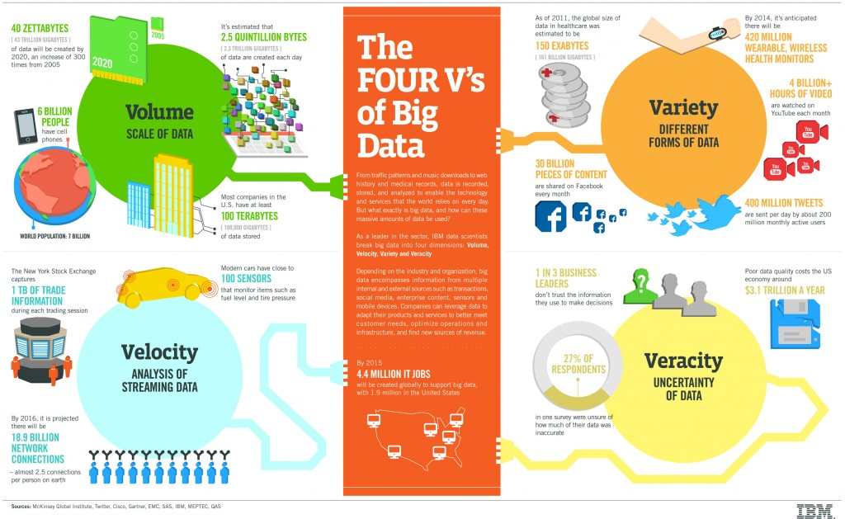
Notes:
Big Data is the data which cannot be managed by using traditional databases.
History of Big Data
Roger Magoulas, in 2005, coined the term ‘Big Data’. In the same year, the development of Hadoop started. It is an open-source framework that could process both structured and unstructured data.
R has a lot to offee for each stages – Base R, stat
Use the shiny package – a little data package
R markdown to publish in a very easy way
R is
Important to realize
Big data with R it is a language but not a piece of software designed to store data
A typical use case is loading data in R, while there R R will hold data in the RAM
Is there a data larger than our computer’s work. Ram on your computer
Assume you work > larger than your computers ram.
Before you work with the data you always have a smaller subsest to work with. If not the you may not be using big data
Scale up step
We have found it helping for into 3 categories . These are not problems that IT has with
Extracting a dataset from your big data (recommendation system). Once you have data, your big data may
Compute on the parts – requires you to use all the data at once. Scale up – class 2 or 3.
Background in statistical
I believe In sampling.
R is used as a glue language. It’s easy to drive experience through other APIs
General strategy to work with big data
Store big data in a data warehouse – designed to store large
R has to communicate with the data
Take subsets of data in warehouse that are small enough to pass into R
Transform r code and pass to data warehouse then apply to where the data lives. There are many big data warehouse solutions, sql server, Sybase, haoop, spark
Send more of yo
Using R as an API to the data warehouse

Slide 11
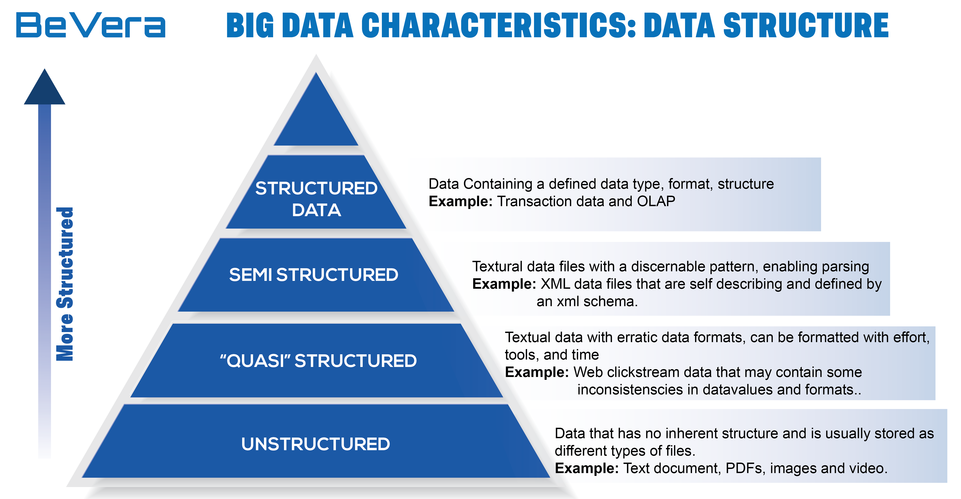
Big Data Characteristics: Data Structure
Notes:
Unstructured data are undefined content that does not fit into database tables. Examples include videos, blog posts, customer reviews, social media posts, video feeds, audio etc. They are heavy texts lumped together. Sorting these type of data is difficult because they are not streamlined.
Unstructured data comes from information that is not organized or easily interpreted by traditional databases or data models, and typically, it’s text-heavy. Metadata, Twitter tweets, and other social media posts are good examples of unstructured data.
Multi-structured data refers to a variety of data formats and types and can be derived from interactions between people and machines, such as web applications or social networks. A great example is web log data, which includes a combination of text and visual images along with structured data like form or transactional information.

Slide 12
Traditional Data vs. Big Data
Challenges
Advantages
Notes:
Few questions generally arise when we talk about the density of data.
Who makes use of this much data?
Who are the ones analyzing it?
What is required to analyze it?
A large amount of data that is generated is analyzed by various Big Data professionals such as Data Scientists, Architects, and Engineers by using different Big Data techniques and skills.
Therefore, the demand for Big Data professionals with a skill set is on the rise. On the other hand, the supply remains low which creates great job opportunities for individuals within this field.
Career opporuntities/high salaries (demand)
Let’s discuss to be effective/successful, you must understand:
The heterogeneity of biological data is certainly a challenge. Possibility to also use data to refine data.
To be effective in …healthcare industrial research, big data is the life science domain need to be organized, well annotated, catalogued, correlated and integrated.
basic microbial genomics
Genome data formats, - The GDC currently accepts DNA and RNA sequencing data in both FASTQ(link is external) and BAM(link is external) formats.
retrieving sequence data from repositories, and QC
De novo genome assemblies and annotation
Mapping and SNP calling
Pangenome analysis
Phylogenetics
Interpreting your data

Slide 13
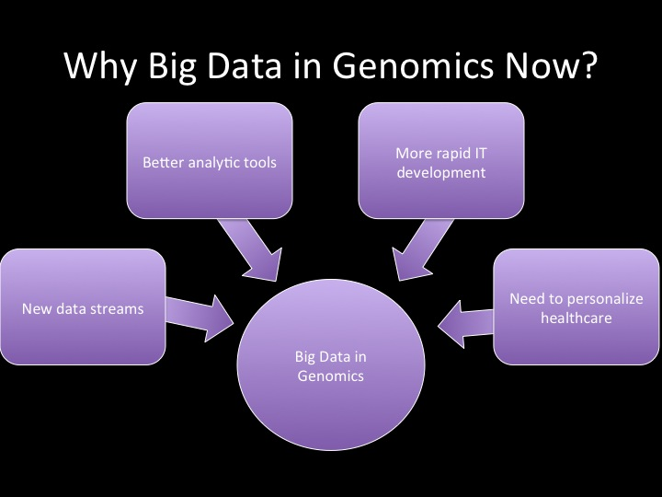
Notes:
Volume is not a super challenge currently?
Better decision making
Greater innovations - create new products and services for their customers. Able to analyze different customers’ opinions about their products and how their product is perceived. Info in what is lacking and what is significant.
-serves as a backbone to IoT
Product price optimization – set to profit maximized balance customer’s willingness to pay
Recommendation engines – recommendations based on previous and current choices made on various online platforms (shopping platforms – think about this during pandemic)
Life-Saving application in the healthcare industry - would help practitioners to provide advanced and quality healthcare to their patients based on the electronic health records of the patient. It enhances the overall operational efficiency of the healthcare companies and has allowed them to make the required changes. Big Data Analytics would allow them to find a better cure for a disease by recognizing unknown connections and hidden patterns.

Slide 14
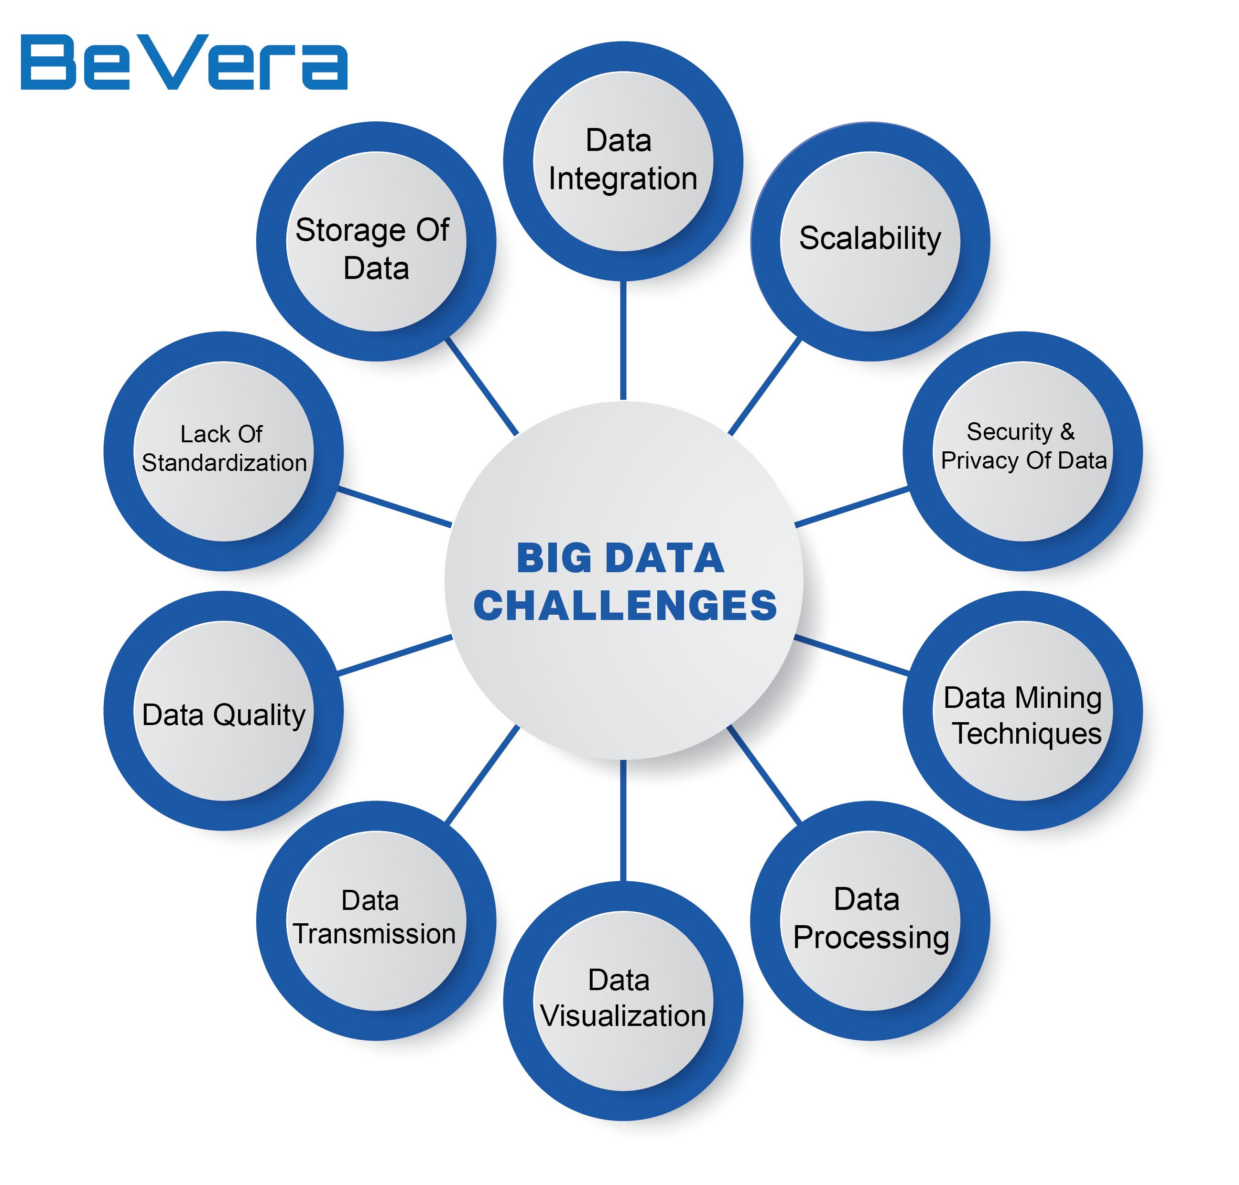
Notes:
Current challenges in public health
Public health data is widely distributed to data sharing
Volume rapidly growing
Many cultural, social and political impediments
Requires a stronger economic model for long term financial sustainability
Uniquely dynamic, complex and global in scale (situational awareness, population health, event detection, inventory tracking, alerting
Many redundant systems, application silos and data silos
Predict the daily patients income to tailor staffing accordingly
Use Electronic Health Records (EHRs)
Use real-time alerting for instant care
Help in preventing opioid abuse in the US
Enhance patient engagement in their own health
Use health data for a better-informed strategic planning
Research more extensively to cure cancer
Use predictive analytics
Reduce fraud and enhance data security
Practice telemedicine
Integrate medical imaging for an broader diagnosis
Prevent unnecessary ER visits

Slide 15
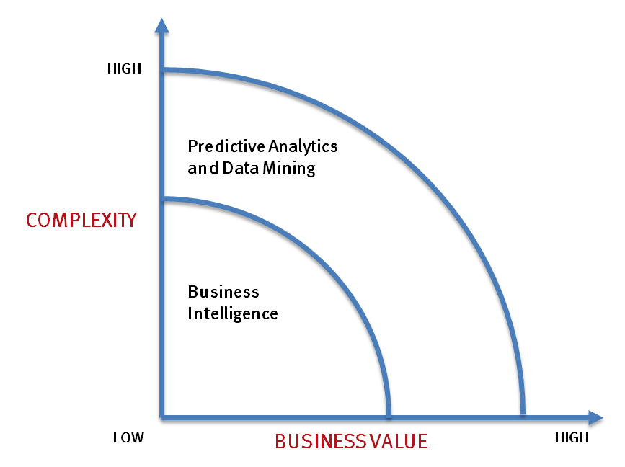
What’s Driving Big Data
- Optimizations and predictive analytics
- Complex statistical analysis
- All types of data, and many sources
- Very large datasets
- More of a real-time
Common questions
What if…
What’s the optimal scenario for our business?
What will happen next? What if these trends continue? Why is this happening?
- Ad-hoc querying and reporting
- Data mining techniques
- Structured data, typical sources
- Small to mid-size datasets
Common questions
What happened last quarter?
How many did we sell?
Where is the problem? In which situation?

Slide 16
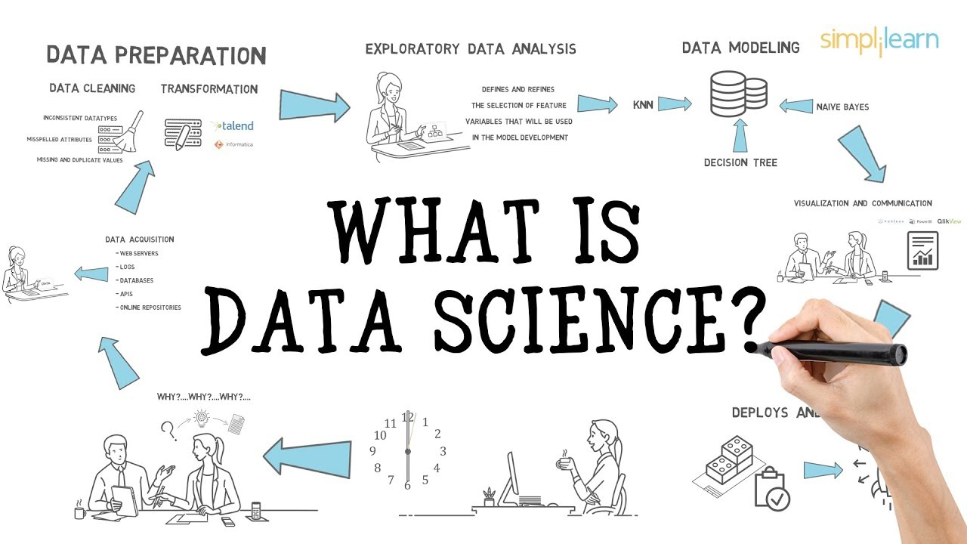
Notes:
Data wrangling - Messy process of sourcing, mapping and transforming raw data. A clean data set worth analyzing, visualizing and extracting new knowledge.
Computing - Computer programming is usually a very specific directed task with a specific functionality in mind.
Data Mining - data mining algorithm is a well-defined procedure that takes data as input and produces output in the form of models or patterns.

Slide 17

Module 2: R Programming Basics
https://cran.r-project.org/doc/manuals/R-intro.pdf
Notes:
- We use R to explore, analyze, and understand public health data.
- There’s a an amazing community
- Clean analyze plot and communicate with your data all in one place
We analyze data straight out of tables provided in reports or articles
Full-function calculator
Extensible statistical package
High-quality graphics tool
Multi-use programming language
ell as analyze usual data sets.

Slide 18
Setting up your machine
Download a copy of R on your local computer from the Comprehensive R Archive Network (CRAN). You can choose between binaries for Linux, Mac and Windows.
Install one of R’s integrated development environment (IDE), RStudio, which makes R coding much easier and faster as it allows you to type multiple lines of code, handle plots, install and maintain packages and navigate your programming environment much more productively.
Install all suggested packages or dependencies including GUI.
https://cran.r-project.org/doc/manuals/R-intro.pdf
Notes:
If you currently use another statistical package, why learn R?
It's free! If you are a teacher or a student, the benefits are obvious.
It runs on a variety of platforms including Windows, Unix and MacOS.
It provides an unparalleled platform for programming new statistical methods in an easy and straightforward manner.
It contains advanced statistical routines not yet available in other packages.
It has state-of-the-art graphics capabilities.

Slide 19
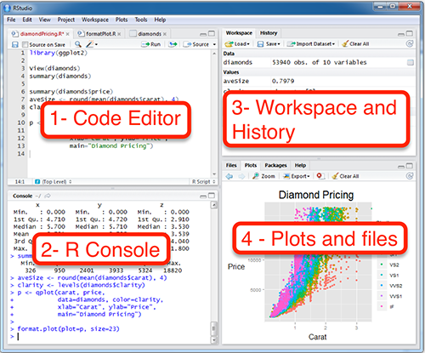
RStudio is a four pane work-space for 1) creating file containing R script, 2) typing R commands, 3) viewing command histories, 4) viewing plots and more.
3.Top-right panel: ◦Workspace tab: shows the list of R objects you created during your R session ◦History tab: shows the history of all previous commands
1.Top-left panel:
◦Code editor allowing you to create and open a file containing R script.
◦The R script is where you keep a record of your work. R script can be created as follow: File –> New –> R Script
4.Bottom-right panel:
◦Files tab: show files in your working directory ◦Plots tab: show the history of plots you created. From this tab, you can export a plot to a PDF or an image files ◦Packages tab: show external R packages available on your system. If checked, the package is loaded in R.
2.Bottom-left panel:
◦R console for typing R commands

Slide 20

Importing your data
R allows for the import of different data formats using specific packages that can make your job easier:
Example: mydata=read.csv(file=“c:/…..csv”, header=TRUE)
https://www.datacamp.com/community/tutorials/r-data-import-tutorial
Notes:
Webscraping?
Comprehensive and easy R Data Import tutorial covering everything from importing simple text files to the more advanced SPSS and SAS files.
`Almost every single type of file that you want to get into R seems to require its own function

Slide 21

Manipulating your data
Notes:
manipulating it using these packages:

Slide 22
Using packages
1
2
install.packages("haven")
library("haven")
Downloads files to computer
Loads package
1 x per computer
1 x per R Session
CC BY-SA RStudio

Slide 23
R is Infinitely Expandable
Applications of R normally use a package; i.e., a library of special functions designed for a specific problem.
Hundreds of packages are available, mostly written by users.
A user normally only loads a handful of packages for a particular analysis (e.g., library(caret)).
Standards determine how a package is structured, works well with other packages and creates new data types in an easily used manner.
Standardization makes it easy for users to learn new packages.

Slide 24
Additional resources for R programming basics
http://www.sthda.com/english/wiki/easy-r-programming-basics
https://www.rstudio.com/resources/webinars/data-wrangling-with-r-and-rstudio/
https://github.com/rstudio/webinars/blob/master/05-Data-Wrangling-with-R-and-RStudio/wrangling-webinar.pdf

Slide 25
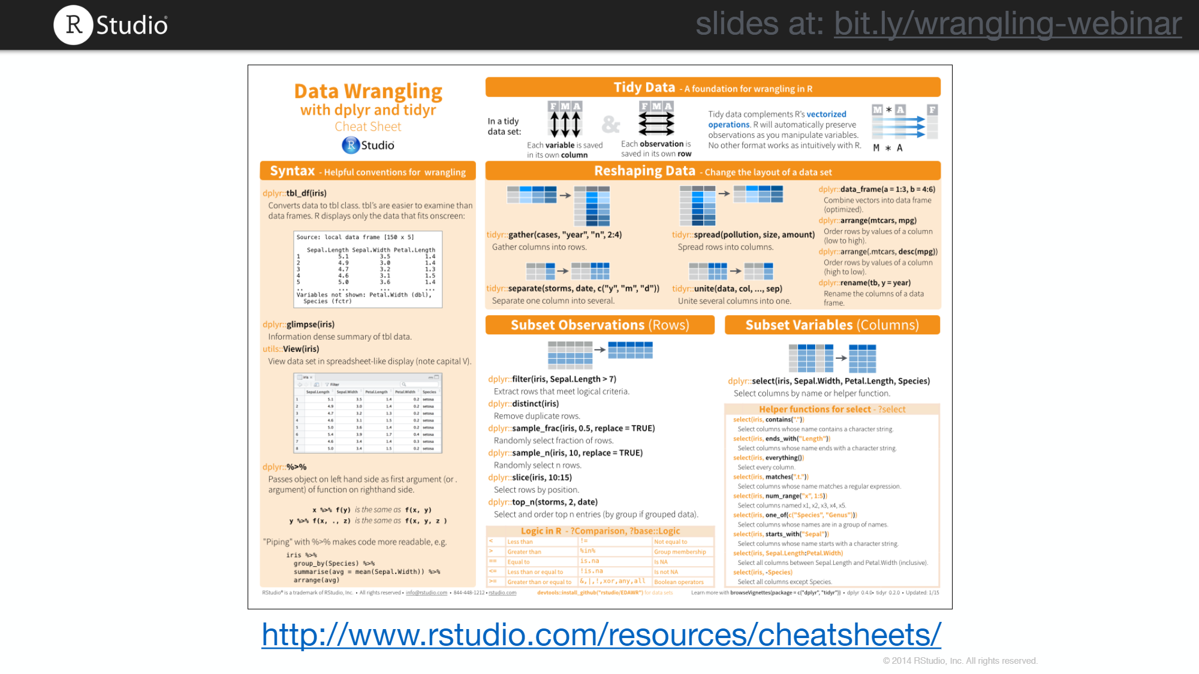
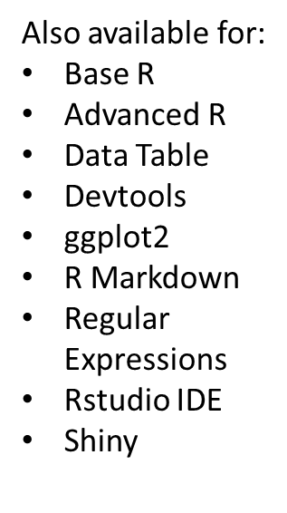

Slide 26
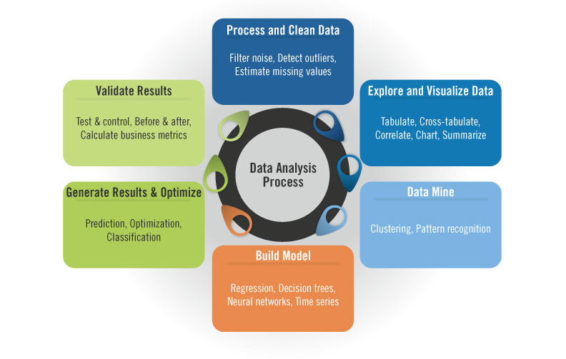
Steps of Data Analysis
Notes:
1. Data collection - combination of the following: a) answering other related questions, b) dealing with data quality issues that are later realized, and, c) including new data sets to the analysis
2. Quality checks and cleaning with imperfect data. It is common to have missing values or measurements that are noisy.
High-throughput genomics data embeds technical biases into the data
3. Data processing - How to combat data not coming into a ready to analyze format
see relationship between variables measured, relationship between samples based on the variables measured.
EDA and modeling.
This generally refers to modeling your variable of interest based on other variables you measured. In the context of genomics, it could be that you are trying to predict disease status of the patients from expression of genes you measured from their tissue samples. Then your variable of interest is the disease status and
4. Visualization Basic plots: Histograms, scatter plots, bar plots, box plots, heatmaps
ideograms and circos plots for genomics provides visualization of different features over the whole genome.

Slide 27
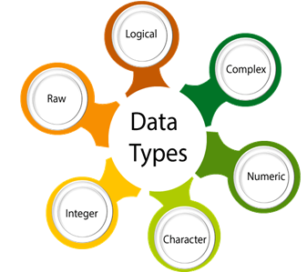
Notes:
R has five data types which are:
Numeric - The numeric data type is for numeric values. It is the default data type for numbers in R.
Integers
Complex
Logical
Characters

Slide 28
Data Types in R
Notes:
Include raw
R has five data types which are:
Numeric - The numeric data type is for numeric values. It is the default data type for numbers in R.
Integers
Complex
Logical
Characters
can also use the capital ‘L’ notation to denote that a particular value is of the integer data type
4.5 is a decimal value called numerics.
4 is a natural value called integers. Integers are also numerics.
TRUE or FALSE is a Boolean value called logical.
The value inside " " or ' ' are text (string). They are called characters.
check the type of a variable with the class function

Slide 29
Data Object Types
Core
Derived
Notes:
Core - data types, or modes, define how the values are stored in the computer. You can get an object’s mode using the typeof() function.
Numeric, character, logical
Derived - these data types are stored as either numeric, character or logical but have additional attribute information that allow these objects to be treated in special ways by certain functions in R. These attributes define an object’s class and can be extracted from that object via the class() function.
Factor - normally used to group variables into a fixed number of unique categories or levels.
For example, a dataset may be grouped by gender or month of the year. Such data are usually loaded into R as a numeric or character data type requiring that they be converted to a factor using the as.factor() function.

Slide 30
# Declare variables of different types
Example 1:
# Numeric
x <- 28
class(x)
Output: ## [1] "numeric"
Example 2:
# String
y <- "R is Fantastic"
class(y)
Output: ## [1] "character“
Example 3:
# Boolean
z <- TRUE
class(z)
Output: ## [1] "logical"
Notes:
The simplest object type in R is a scalar. A scalar object is just a single value like a number or a name.
Scalars don’t have to be numeric, they can also be characters (also known as strings).
As you can imagine, R treats numeric and character scalars differently. For example, while you can do basic arithmetic operations on numeric scalars – they won’t work on character scalars.
Note - Error in a + b: non-numeric argument to binary operator
If you see an error like this one, it means that you’re trying to apply numeric operations to character objects.

Slide 31
Variables
Variables store values and are an important component in programming. A variable can store a number, an object, a statistical result, vector, dataset, a model prediction basically anything R outputs. We can use that variable later simply by calling the name of the variable.
To declare a variable, we need to assign a variable name. The name should not have space. We can use _ to connect to words.
To add a value to the variable, use <- or =.
Here is the syntax:
# First way to declare a variable: use the `<-`
name_of_variable <- value
# Second way to declare a variable: use the `=`
name_of_variable = value

Slide 32
In the command line, we can write the following codes to see what happens:
Example 1:
# Print variable x
x <- 42
x
Output: ## [1] 42
Example 2:
y <- 10
y
Output: ## [1] 10
Example 3:
# We call x and y and apply a subtraction
x-y
Output: ## [1] 32

Slide 33
Basic Arithmetic Operators
:
Operator | Description
+ | Addition
- | Subtraction
* | Multiplication
/ | Division
^ or ** | Exponentiation
Notes:
Logical vectors will be coerced to integer or numeric vectors, FALSE having value zero and TRUE having value one.
1 ^ y and y ^ 0 are 1, always. x ^ y should also give the proper limit result when either (numeric) argument is infinite (one of Inf or -Inf).
Objects such as arrays or time-series can be operated on this way provided they are conformable.
For double arguments, %% can be subject to catastrophic loss of accuracy if x is much larger than y, and a warning is given if this is detected.
%% and x %/% y can be used for non-integer y, e.g. 1 %/% 0.2, but the results are subject to representation error and so may be platform-dependent. Because the IEC 60559 representation of 0.2 is a binary fraction slightly larger than 0.2, the answer to 1 %/% 0.2 should be 4 but most platforms give 5.
Users are sometimes surprised by the value returned, for example why (-8)^(1/3) is NaN. For double inputs, R makes use of IEC 60559 arithmetic on all platforms, together with the C system function pow for the ^ operator. The relevant standards define the result in many corner cases. In particular, the result in the example above is mandated by the C99 standard. On many Unix-alike systems the command man pow gives details of the values in a large number of corner cases.
Arithmetic on type double in R is supposed to be done in ‘round to nearest, ties to even’ mode, but this does depend on the compiler and FPU being set up correctly.

Slide 34
# Examples:
# A multiplication
3*9
Output: ## [1] 27
# A division
(5+13)/2
Output: ## [1] 9
# Exponentiation
-3^2
Output: ## [1] 9
Notes:
The ## means we print an output and the number in the square bracket ([1]) is the number of the display
The sentences starting with # annotation. We can use # inside an R script to add any comment we want. R won't read it during the running time.
Does everyone agree with the output? – should be -9 not 9 - Syntax matters – conversation should start

Slide 35
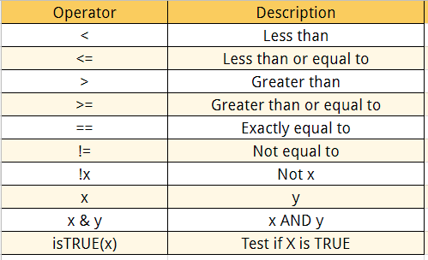
Logical Operators return values inside the vector based on logical conditions.
You can add many conditional statements but we need to include them in a parenthesis. Follow this structure to create a conditional statement:
variable_name[(conditional_statement)]

Slide 36
# Example:
# Create a vector from 1 to 8
logical_vector <- c(1:8)
logical_vector > 6
Output: ## [1]FALSE FALSE FALSE FALSE FALSE FALSE TRUE TRUE
# Example:
logical_vector <- c(1:8)
logical_vector[(logical_vector>3) & (logical_vector<5)]
Output: ## [1] 4

Slide 37
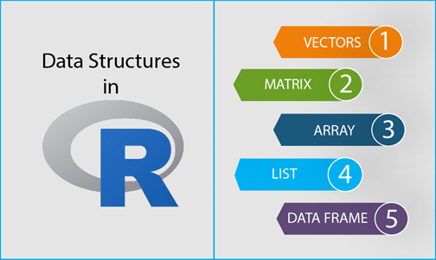

Slide 38
Learning objectives of this module:
What are the three properties of a vector, other than its contents?
What are the four common types of atomic vectors? What are the two rare types?
What are attributes? How do you get them and set them?
How is a list different from an atomic vector? How is a matrix different from a data frame?
Can you have a list that is a matrix?

Slide 39
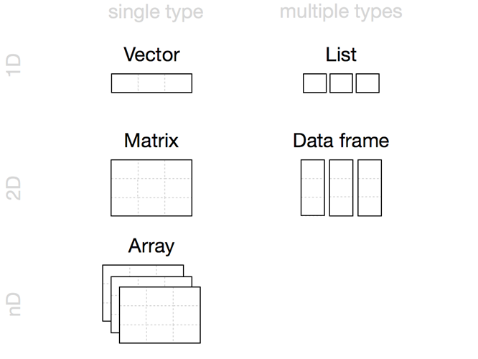
Fundamental Data Structures
Vector
Matrix
Array
A sequence of numbers or characters, or higher-dimensional arrays like matrices
The basic two dimensional data structure in R is the vector
List
A table-like structure (experimental results often collected in this form)
Factor
A sequence assigning a category to each index.
Data.Frame
If a higher dimension vector is desired, then use the function to generate the n-dimensional object.
An ordered set of components stored in a 1D vector
Notes:
Basic data types - R Programming works with numerous data types, including:
environment - hash table. A collection of key-value pairs classes of objects, like expression data, are built from these. Most commands in R involve applying a function to an object.
R’s base data structures can be organized by their dimensionality (1d, 2d, or nd) and whether they’re homogeneous (all contents must be of the same type) or heterogeneous (the contents can be of different types). This gives rise to the five data types most often used in data analysis.
Given an object, the best way to understand what data structures it’s composed of is to use str(). str() is short for structure and it gives a compact, human readable description of any R data structure.
Matrices in R can be thought of as vectors indexed using two indices instead of one.

Slide 40
Atomic Data Elements: Vectors
In R the “base” type is a vector, not a scalar.
A vector is an indexed set of values that are all of the same type. The type of the entries determines the class of the vector.
The possible vectors data types are:
• integer
• numeric
• character
• complex
• logical
• An integer is a subclass of numeric.
• Cannot combine vectors of different modes
Notes:
A scalar object is just a single value like a number or a name. a <- 100 or b <- 3 / 100 or c <- (a + b) / b
Vector is the most basic data structure in R programming language.
A vector object is just a combination of several scalars stored as a single object.
It comes in two parts: Atomic vectors and Lists. They have three common properties:
Type function – what actually it is?
Length function – how many elements does it contain.
Attribute function – extra arbitrary metadata.
Vectors (numerical, character, logical)

Slide 41
Creating Vectors
Assignment of a value to a variable is done with <- (two symbols, no space).
> v <- 1
V
Vectors can only contain entries of the same type: numeric or character; you can’t mix them.
Note that characters should be surrounded by “ ”. The most basic way to create a vector is with c(x1, . . . , xn), and it works for characters and numbers alike.
> x <- c("a", "b", "c")
> length(x)
[1] 3
Can also generate regular sequences:
seq(from = #, to = #, by = #): allows you to create a sequence from a starting number to an ending number.
rep(x = c(1, 2), each = 3): function allows you to repeat a scalar (or vector) a specified number of times, or to a desired length.
Notes:
Emphasis blue statement
There are many ways to create vectors in R. Here are the methods we will cover in this chapter:
c(a, b, ...) c(1, 5, 9) 1, 5, 9 - - two numeric scalars a and b as arguments, and returns a vector of numbers from the starting point a to the ending point b in steps of 1.
a:b 1:5 1, 2, 3, 4, 5
seq(from, to, by, length.out) seq(from = 0, to = 6, by = 2) 0, 2, 4, 6
- from - The start of the sequence - toThe end of the sequence - by. The step-size of the sequence - length.outThe desired length of the final sequence (only use if you don’t specify by)
rep(x, times, each, length.out) rep(c(7, 8), times = 2, each = 2) 7, 7, 8, 8, 7, 7, 8, 8
- also rep(x = 1:3, length.out = 10), rep(x = 3, times = 10)
The simplest way to create a vector is with the c() function. The c here stands for concatenate

Slide 42
Vector Arithmetic
Numeric vectors can be used in arithmetic expressions, in which case the operations are performed element by element to produce another vector.
> x <- rnorm(3)
> y <- rnorm(3)
> x
> x + 1
> c(1, 2, 3, 4, 5) + c(5, 4, 3, 2, 1)
Notes:
If you do an operation on a vector with a scalar, R will apply the scalar to each element in the vector.
a <- 1:5
b <- 1:5
ab.sum <- a + b
ab.diff <- a - b
ab.prod <- a * b
ab.sum
## [1] 2 4 6 8 10
ab.diff
## [1] 0 0 0 0 0
ab.prod
## [1] 1 4 9 16 25

Slide 43
More Vector Arithmetic Statistical operations on numeric vectors
In studying data you will make frequent use of sum, which gives the sum of the entries, max, min, mean.
> (i.e. Sum((x - mean(x))^2)/(length(x) - 1))
A useful function for quickly getting properties of a vector: summary(y)
Notes:
x <- rnorm(3)
x
y <- rnorm (3)
y
var(x) > var(x)
sum((x - mean(x))^2)/(length(x) - 1)
summary(y)
length(a)

Slide 44
More Vector Arithmetic Statistical operations on continuous vectors

Slide 45
Vector Arithmetic Statistical operations on discrete vectors
Notes:
vec <- c(1, 1, 1, 5, 1, 1, 10, 10, 10)
The function unique(x) will tell you all the unique values in the vector, but won’t tell you anything about how often each value occurs.
The function table() does the same thing as unique(), but goes a step further in telling you how often each of the unique values occurs:
table(vec)
If you want to get a table of percentages instead of counts, you can just divide the result of the table() function by the sum of the result:
table(vec) / sum(table(vec))

Slide 46
# See the “indexing vectors.R” in the folder

Slide 47
Factors in R: Categorical & Continuous Variables
Factors are variables in R which take on a limited number of different values; such variables are often referred to as categorical variables.
In a dataset, we can distinguish two types of variables:
In a categorical variable, the value is limited and usually based on a particular finite group. For example, a categorical variable can be countries, year, gender, occupation.
A continuous variable, however, can take any values, from integer to decimal. For example, we can have the revenue, price of a share, etc..
categorical and continuous

Slide 48
Categorical Variables
R stores categorical variables into a factor. Let's check the code below to convert a character variable into a factor variable. Characters are not supported in a machine learning algorithm, and the only way is to convert a string to an integer.
Syntax
Arguments:
x: A vector of data. Need to be a string or integer, not decimal.
Levels: A vector of possible values taken by x. This argument is optional. The default value is the unique list of items of the vector x.
Labels: Add a label to the x data. For example, 1 can take the label `male` while 0, the label `female`.
ordered: Determine if the levels should be ordered.
factor(x = character(), levels, labels = levels, ordered = is.ordered(x))

Slide 49
Nominal Categorical Variable
A categorical variable has several values but the order does not matter. For instance, male or female categorical variable do not have ordering.
# Create a color vector
color_vector <- c(‘turquoise', 'red', 'green', ivory', 'black', 'yellow')
# Convert the vector to factor
factor_color <- factor(color_vector)
factor_color
Output:
## [1] turquoise red green ivory black yellow
## Levels: black turquoise green red ivory yellow
Notes:
From the factor_color, we can't tell any order
Why would you go from vector to factor?
Can we go back from factor to vector?

Slide 50
Ordinal Categorical Variable
Ordinal categorical variables do have a natural ordering. We can specify the order, from the lowest to the highest with order = TRUE and highest to lowest with order = FALSE.
Example: We can use summary to count the values for each factor.
# Create Ordinal categorical vector
day_vector <- c('evening', 'morning', 'afternoon', 'midday', 'midnight', 'evening')
# Convert `day_vector` to a factor with ordered level
factor_day <- factor(day_vector, order = TRUE, levels =c('morning', 'midday', 'afternoon', 'evening', 'midnight'))
# Print the new variable
factor_day
Output:
## [1] evening morning afternoon midday midnight evening
Example:
## Levels: morning < midday < afternoon < evening < midnight
# Append the line to above code
# Count the number of occurrence of each level summary(factor_day)
Output:
## morning midday afternoon evening midnight
## 1 1 1 2 1
Notes:
?

Slide 51
Continuous Variables
Continuous class variables are the default value in R.
They are stored as numeric or integer.
We can see it from the dataset below. mtcars is a built-in dataset. It gathers information on different types of car. We can import it by using mtcars and check the class of the variable mpg, mile per gallon. It returns a numeric value, indicating a continuous variable.
dataset <- mtcars
class(dataset$mpg)
## [1] “numeric”

Slide 52
Lists in R:
A list is a generic object consisting of an ordered collection of objects.
Lists are heterogeneous data structures.
A list is an one-dimensional data structures.
A list can be a list of vectors, list of matrices, a list of characters and a list of functions and so on.
Lists are different from atomic vectors because their elements can be of any type, including lists.
You construct lists by using list() instead of c():
x <- list(1:5, “d", c(FALSE, FALSE, TRUE), c(3.5 7.2))
str(x)

Slide 53
# Example - Illustrate a List
# The first attributes is a numeric vector
# containing the employee IDs which is
# created using the 'c' command here
empId = c(1, 2, 3, 4)
# The second attribute is the employee name
# which is created using this line of code here
# which is the character vector
empName = c(“Ann", “Sanjan", “Ellison", “Evette")
# The third attribute is the number of employees
# which is a single numeric variable.
numberOfEmp = 4
# We can combine all these three different
# data types into a list
# containing the details of employees
# which can be done using a list command
empList = list(empId, empName, numberOfEmp)
print(empList)
Notes:
DO THIS EXAMPLE
List Slicing
We retrieve a list slice with the single square bracket "[]" operator. The following is a slice containing the second member of x, which is a copy of s.
of submitting a patient list
> n = c(3,6,8) > s = c("aa", "bb", "cc", "dd", "ee") > b = c(FALSE, FALSE, TRUE, TRUE, FALSE) > x = list(n, s, b, 3) # x contains copies of n, s, b
> x[2] [[1]]
With an index vector, we can retrieve a slice with multiple members. Here a slice containing the second and fourth members of x.
> x[c(2, 4)] [[1]] [1] "aa" "bb" "cc" "dd" "ee" [[2]] [1] 3
Member Reference
In order to reference a list member directly, we have to use the double square bracket "[[]]" operator. The following object x[[2]] is the second member of x. In other words, x[[2]] is a copy of s, but is not a slice containing s or its copy.
> x[[2]] [1] "aa" "bb" "cc" "dd" "ee"
We can modify its content directly.
> x[[2]][1] = "ta" > x[[2]] [1] "ta" "bb" "cc" "dd" "ee" > s [1] "aa" "bb" "cc" "dd" "ee" # s is unaffected

Slide 54
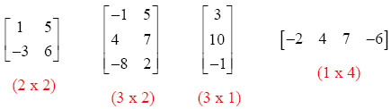
Matrix – What is a Matrix?
A matrix is a 2-dimensional array that has m number of rows and n number of columns. In other words, matrix is a combination of two or more vectors with the same data type.
You can create a matrix with the function matrix(). This function takes three arguments:
Arguments:
data: The collection of elements that R will arrange into the rows and columns of the matrix.
nrow: Number of rows
ncol: Number of columns
byrow: The rows are filled from the left to the right. We use `byrow = FALSE` (default values), if we want the matrix to be filled by the columns i.e. the values are filled top to bottom.
matrix(data, nrow, ncol, byrow = FALSE)
Notes:
What about 3d? Without matrix operations – you would have to push
Color matrices?.....
A matrix can store data of a single basic type (numeric, logical, character, etc.). Therefore, a matrix can be a combination of two or more vectors.
Rectangular data set
Fixed number of rows and columns
row: Number of rows we wish to create in matrix.
However, it was not until 1850, when the concept of the matrix was actually applied.
“Matrix” is the Latin word for womb. Generally, it can also mean any place in which something is formed or produced. The word has been used in unusual ways by at least two authors of historical importance. They proposed this axiom as a means to reduce any function to one of the lower types so that at the “bottom” (0order) the function is identical to its extension.
By using the process of generalisation, any possible function other than a matrix from the matrix holds true. However, it is only true if the proposition which asserts function in question is considered. Furthermore, it holds true for all or one of the value of argument when other argument(s) is undetermined.
Wait! Have you checked – R List Tutorial

Slide 55
#Print dimension of the matrix with dim()
Defining names of columns and rows in a matrix
# Print dimension of the matrix with dim()
dim(matrix_a)
In order to define rows and column names, you can create two vectors of different names, one for row and other for a column. Then, using the Dimnames attribute, you can name them appropriately:
rows = c("row1", "row2", "row3", "row4") #Creating our character vector of row names
cols = c("coln1", "coln2", "coln3") #Creating our character vector of column names
mat <- matrix(c(4:15), nrow = 4, byrow = TRUE, dimnames = list(rows, cols) )
#creating our matrix mat and assigning our vectors to dimnames
# Print matrix
print(mat)
Notes:
Note – It is not necessary to specify both nrow and ncol. Only one of the two is required. R calculated the other based on the length of the data.
We can also create an R matrix by changing a vector’s dimensions using the dim() function.
Code:
> mat5 <- c(2,3,5,9)
> mat5
Code:
> dim(mat5) <- c(2,2)
> mat5

Slide 56
Add a Column to a Matrix with the cbind()
You can add a column to a matrix with the cbind() command.
cbind() means column binding. cbind() can concatenate as many matrix or columns as specified.
Example:
# concatenate c(1:5) to the matrix_a
matrix_a1 <- cbind(matrix_a, c(1:5))
# Check the dimension dim(matrix_a1)
Output:
## [1] 5 3
Example:
matrix_a1
Output
## [,1] [,2] [,3]
## [1,] 1 2 1
## [2,] 3 4 2
## [3,] 5 6 3
## [4,] 7 8 4
## [5,] 9 10 5
Notes:
NOTE: The number of rows of matrices should be equal for cbind work

Slide 57
Example:
We can also add more than one column. Add the next sequence of number to the matrix_a2 matrix. The dimension of the new matrix will be 4x6 with number from 1 to 24.
matrix_a2 <-matrix(13:24, byrow = FALSE, ncol = 3)
## [,1] [,2] [,3]
## [1,] 13 17 21
## [2,] 14 18 22
## [3,] 15 19 23
## [4,] 16 20 24
Example:
matrix_c <-matrix(1:12, byrow = FALSE, ncol = 3)
matrix_d <- cbind(matrix_a2, matrix_c)
dim(matrix_d)
Output:
## [1] 4 6
Notes:
NOTE: The number of rows of matrices should be equal for cbind work
cbind()concatenate columns, rbind() appends rows. Let's add one row to our matrix_c matrix and verify the dimension is 5x3
matrix_c <-matrix(1:12, byrow = FALSE, ncol = 3) # Create a vector of 3 columns add_row <- c(1:3) # Append to the matrix matrix_c <- rbind(matrix_c, add_row) # Check the dimension dim(matrix_c)

Slide 58
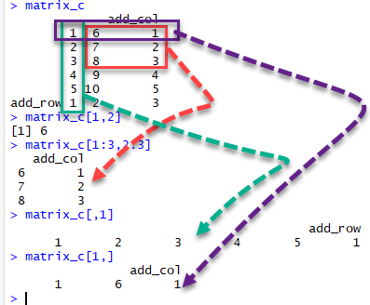
Slice a Matrix: Accessing individual components
We can select elements one or many elements from a matrix by using the square brackets [ ]. This is where slicing comes into the picture.
For example:
matrix_c[1,2] selects the element at the first row and second column.
matrix_c[1:3,2:3] results in a matrix with the data on the rows 1, 2, 3 and columns 2, 3,
matrix_c[,1] selects all elements of the first column.
matrix_c[1,] selects all elements of the first row.
Notes:
using square brackets as mat[row, col], where row and col are the vectors. We can use the vector indexing techniques to index a matrix, similar to vector indexing.

Slide 59
# Examples:
> A = matrix( + c(2, 4, 3, 1, 5, 7), # the data elements + nrow=2, # number of rows + ncol=3, # number of columns + byrow = TRUE) # fill matrix by rows
> A
> A[2, 3] # element at 2nd row, 3rd column
> A[2, ] # the 2nd row
> A[ ,c(1,3)] # the 1st and 3rd columns
> t(A) # transpose of B
> c(B) # deconstruct a matrix
Notes:
Let’s reproduce a memory representation of the matrix in R with the matrix function. The data elements must be of the same basic type.
# deconstruct a matrix by applying the c function, which combines all column vectors into one.

Slide 60
Functions for viewing matrices and dataframes and returning information about them.
Function | Description
head(x), tail(x) | Print the first few rows (or last few rows).
View(x) | Open the entire object in a new window
nrow(x), ncol(x), dim(x) | Count the number of rows and columns
rownames(), colnames(), names() | Show the row (or column) names
str(x), summary(x) | Show the structure of the dataframe (ie., dimensions and classes) and summary statistics
Notes:
To see the first few rows of a dataframe, use head(), to see the last few rows, use
To see an entire dataframe in a separate window that looks like spreadsheet, use View()
To learn about the classes of columns in a dataframe, in addition to some other summary information, use the str() (structure) function. This function returns information for more advanced R users, so don’t worry if the output looks confusing.

Slide 61
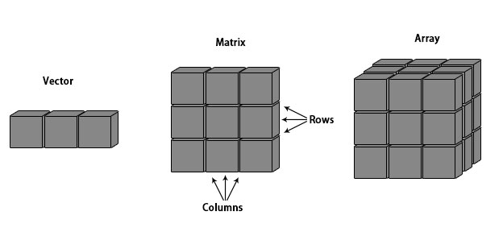
Introduction to Arrays in R
In arrays, data is stored in the form of matrices, rows, and columns.

Slide 62
R Array Syntax
Array_NAME <- array(data, dim = (row_Size, column_Size, matrices, dimnames)
data – Data is an input vector that is given to the array.
matrices – Array in R consists of multi-dimensional matrices.
row_Size – row_Size describes the number of row elements that an array can store.
column_Size – Number of column elements that can be stored in an array.
dimnames – Used to change the default names of rows and columns to the user’s preference.
Arguments in Array
The array function in R can be written as:
array(data = NA, dim = length(data), dimname = NULL)
data is a vector that provides data to fill the array.
dim attribute provides maximum indices in each dimension
dimname can be either NULL or can have a name for the array.

Slide 63
How to Create an Array in R
# Example:
# Create two vectors of different lengths.
vector1 <- c(2,8,3)
vector2 <- c(10,14,17,12,11,15)
# Take these vectors as input to the array.
result <- array(c(vector1,vector2), dim = c(3,3,2))
print(result)

Slide 64
Different Operations on Rows and Columns
Naming Columns And Rows
# Example:
# Create two vectors of different lengths.
vector1 <- c(2,8,3)
vector2 <- c(10,14,17,12,11,15)
column.names <- c("COL1","COL2","COL3")
row.names <- c("ROW1","ROW2","ROW3")
matrix.names <- c("Matrix1","Matrix2")
# Take these vectors as input to the array.
result <- array(c(vector1,vector2),dim = c(3,3,2), dimnames = list(row.names, column.names, matrix.names))
print(result)
Notes:
We can give names to the rows, columns, and matrices in the array by using the dimnames parameter.
1. Add the names (column, row and matrix), 2. add dim names

Slide 65
# Print the third row of the first matrix of the array.
print(result[3,,1])
# Print the element in the 2nd row and 3rd column of the 2nd matrix.
print(result[2,3,2])
# Print the 2nd Matrix.
print(result[,,2])

Slide 66
Manipulating R Array Elements
# Example:
# Create two vectors of different lengths.
vector1 <- c(1,4,6)
vector2 <- c(2,3,5,6,7,9)
# Take these vectors as input to the array.
array1 <- array(c(vector1,vector2), dim = c(3,3,2))
# Create two vectors of different lengths.
vector3 <- c(6,4,1)
vector4 <- c(9,7,6,5,3,2)
array2 <- array(c(vector1,vector2), dim = c(3,3,2))

Slide 67
# create matrices from these arrays.
matrix1 <- array1[,,2]
matrix2 <- array2[,,2]
# Add the matrices.
result <- matrix1+matrix2
print(result)

Slide 68
Calculations across R Array Elements
apply()function for calculations in an array in R.
Syntax apply(x, margin, fun)
Following is the description of the parameters used:
x is an array.
a margin is the name of the dataset used.
fun is the function to be applied to the elements of the array.
For Example:
We use the apply() function below in different ways. To calculate the sum of the elements in the rows of an array across all the matrices.

Slide 69
# Example:
# We will create two vectors of different lengths.
vector1 <- c(1,4,6)
vector2 <- c(2,3,5,6,7,9)
# Now, we will take these vectors as input to the array.
new.array <- array(c(vector1,vector2),dim = c(3,3,2))
print(new.array)
# Use apply to calculate the sum of the rows across all the matrices.
result <- apply(new.array, c(1), sum)
print(result)
Notes:
use of c(1)- MARGIN is a variable defining how the function is applied: when MARGIN=1 , it applies over rows, whereas with MARGIN=2 , it works over columns. Note that when you use the construct MARGIN=c(1,2) , it applies to both rows and columns; and. FUN , which is the function that you want to apply to the data

Slide 70
R Data Frames:
Data frames combine the behavior of lists and matrices to make a structure ideally suited for the needs of statistical data. The data frame is a list of vectors which are of equal length.
A data-frame must have column names and every row should have a unique name.
names(), colnames(), and rownames()
Each column must have the identical number of items.
Each item in a single column must be of the same data type.
Different columns may have different data types.
A matrix contains only one type of data, while a data frame accepts different data types (numeric, character, factor, etc.). This makes it a 2-dimensional structure, so it shares properties of both the matrix and the list.
Notes:
What is a Data Frame?
A data frame is the most important data structure for storing data in R.
A data frame has names(), colnames(), and rownames(), although names() and colnames() are the same thing. The length() of a data frame is the length of the underlying list and so is the same as ncol(); nrow() gives the number of rows.

Slide 71
How to Create a Data Frame
We can create a data frame by passing the variable a,b,c,d into the data.frame() function. We can name the columns with name() and simply specify the name of the variables.
data.frame(df, stringsAsFactors = TRUE)
Arguments:
df: It can be a matrix to convert as a data frame or a collection of variables to join
stringsAsFactors: Convert string to factor by default

Slide 72
df <- data.frame(x = 1:3, y = c("a", "b", "c"))
str(df)
#> 'data.frame': 3 obs. of 2 variables:
#> $ x: int 1 2 3
#> $ y: Factor w/ 3 levels "a","b","c": 1 2 3
df <- data.frame(
x = 1:3,
y = c("a", "b", "c"),
stringsAsFactors = FALSE)
str(df)
#> 'data.frame': 3 obs. of 2 variables:
#> $ x: int 1 2 3
#> $ y: chr "a" "b" "c"
Notes:
You create a data frame using data.frame(), which takes named vectors as input:
Because the df takes on as a vector and factor is derived type from a vector. The stringasfactor is turned true.
Beware data.frame()’s default behavior which turns strings into factors. Use stringsAsFactors = FALSE to suppress this behavior:

Slide 73
# Example R program to illustrate dataframe
# A vector which is a character vector
Name = c(“Auriel", "Ray", "Asia")
# A vector which is a character vector
Type = c(“O+", “B-”, “A-")
# A vector which is a numeric vector
Age = c(36, 23, 62)
# To create dataframe use data.frame command
# and then pass each of the vectors
# we have created as arguments
# to the function data.frame()
df = data.frame(Name, Language, Age)
print(df)
Notes:
You create a data frame using data.frame(), which takes named vectors as input:
Beware data.frame()’s default behavior which turns strings into factors. Use stringsAsFactors = FALSE to suppress this behavior:

Slide 74
Because a data.frame is an S3 class, its type reflects the underlying vector used to build it: the list. To check if an object is a data frame, use class() or test explicitly with is.data.frame():
typeof(df)
#> [1] "list"
class(df)
#> [1] "data.frame"
is.data.frame(df)
#> [1] TRUE
You can coerce an object to a data frame with as.data.frame():
A vector will create a one-column data frame.
A list will create one column for each element; it’s an error if they’re not all the same length.
A matrix will create a data frame with the same number of columns and rows as the matrix.
Notes:
Example using as.data_frame

Slide 75
Merging: Combine data frames using cbind() and rbind()
cbind(df, data.frame(z = 3:1))
#> x y z
#> 1 1 a 3
#> 2 2 b 2
#> 3 3 c 1
rbind(df, data.frame(x = 10, y = "z"))
#> x y
#> 1 1 a
#> 2 2 b
#> 3 3 c
#> 4 10 z
When combining column-wise, the number of rows must match, but row names are ignored.
When combining row-wise, both the number and names of columns must match.
Use plyr::rbind.fill() to combine data frames that don’t have the same columns.
Notes:
Merging data:
Add a Column bind or Row bind
The rbind function can be used to combine several vectors, matrices and/or data frames by rows. To join two data frames (datasets) vertically,

Slide 76
It’s a common mistake to try and create a data frame by cbind()ing vectors together. This doesn’t work because cbind() will create a matrix unless one of the arguments is already a data frame. Instead use data.frame() directly:
bad <- data.frame(cbind(a = 1:2, b = c("a", "b")))
str(bad)
#> 'data.frame': 2 obs. of 2 variables:
#> $ a: Factor w/ 2 levels "1","2": 1 2
#> $ b: Factor w/ 2 levels "a","b": 1 2
good <- data.frame(a = 1:2, b = c("a", "b"), stringsAsFactors = FALSE)
str(good)
#> 'data.frame': 2 obs. of 2 variables:
#> $ a: int 1 2
#> $ b: chr "a" "b"
Notes:
It’s a function of the language.
The conversion rules for cbind() are complicated and best avoided by ensuring all inputs are of the same type.
Do not cbind vectors. You don’t want the vector as a factor.

Slide 77
Example:
Let's create a factor data frame.
# Create gender vector
gender_vector <- c("Male", "Female", "Female", "Male", "Male")
class(gender_vector)
# Convert gender_vector to a factor
factor_gender_vector <-factor(gender_vector)
class(factor_gender_vector)
Output:
## [1] "character"
## [1] "factor"
Notes:
It is important to transform a string into factor when we perform Machine Learning task.
A categorical variable can be divided into nominal categorical variable and ordinal categorical variable.

Slide 78
Knowledge Check:
1. What are the three properties of a vector, other than its contents?
The three properties of a vector are type, length, and attributes.
2a. What are the four common types of atomic vectors?
Logical
Integer
Double (sometimes called numeric)
Character
2b. What are the two rare types?
Complex
Raw

Slide 79
Knowledge Check (cont.)
3. What are attributes? How do you get them and set them?
Attributes allow you to associate arbitrary additional metadata to any object. You can get and set individual attributes with attr(x, "y") and attr(x, "y") <- value; or get and set all attributes at once with attributes().
4a. How is a list different from an atomic vector?
The elements of a list can be any type (even a list); the elements of an atomic vector are all of the same type.
4b. How is a matrix different from a data frame?
Similarly, every element of a matrix must be the same type; in a data frame, the different columns can have different types
5a. Can you have a list that is a matrix?
You can make “list-array” by assigning dimensions to a list.
Notes:
What attributes does a data frame possess?
What does as.matrix() do when applied to a data frame with columns of different types?
Can you have a data frame with 0 rows? What about 0 columns?

Slide 80
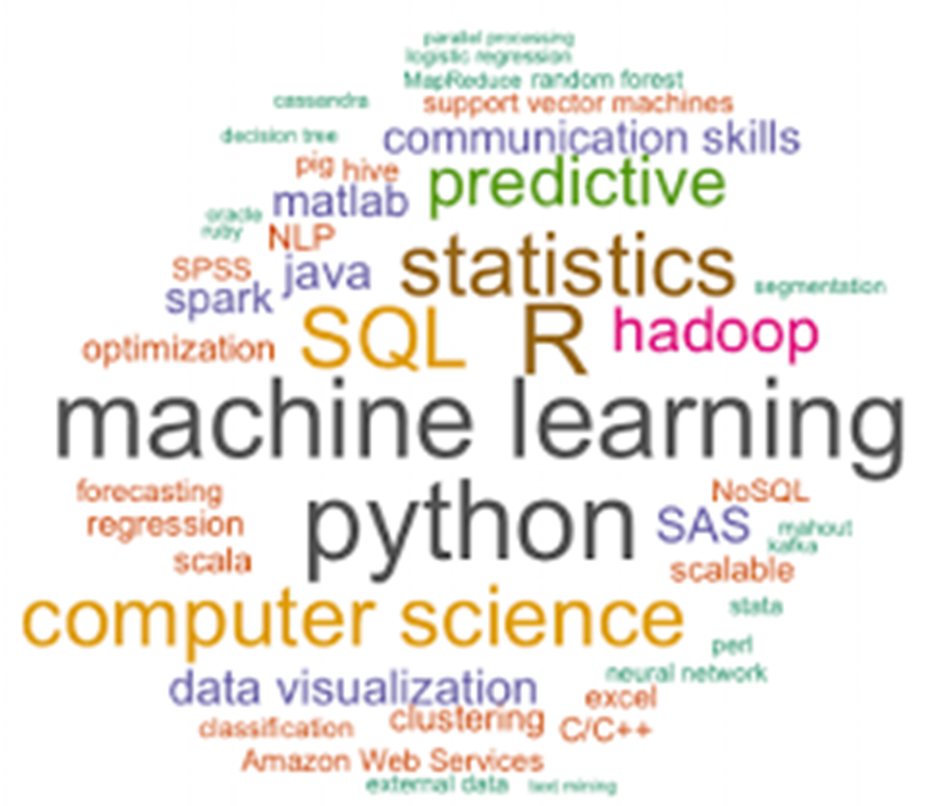
Module 3: Data Science

Slide 81
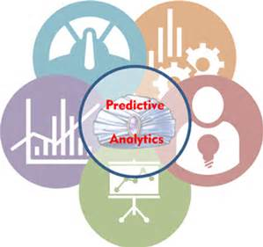
Data Mining? Statistical Modeling? Predictive Analytics?
Predictive analytics is the branch of advanced analytics which is used to make predictions about unknown future events. Predictive analytics uses techniques from data mining, statistics, modeling, machine learning, and artificial intelligence.
Data mining is an analytics process designed to explore data (usually large amounts of data – also known as “big data”). Big data is defined by the volume, velocity, variety, variability and veracity. Data mining is a part of data cleaning that prepares data from multiple sources for analysis. This provides a complete view of the customer interactions.
Data analysis is the process of inspecting, cleaning, transforming and modeling data with the objective of discovering useful information. Statistical Analysis enables to validate assumptions, hypothesis, and test them using standard statistical models.
Predictive modeling provides the ability to automatically create accurate predictive models about future.
Notes:
Volume The quantity of generated and stored data. The size of the data determines the value and potential insight- and whether it can actually be considered big data or not.
Variety The type and nature of the data. This helps people who analyze it to effectively use the resulting insight.
Velocity In this context, the speed at which the data is generated and processed to meet the demands and challenges that lie in the path of growth and development.
Variability Inconsistency of the data set can hamper processes to handle and manage it.
Veracity The quality of captured data can vary greatly, affecting accurate analysis.

Slide 82

Notes:
Feature engineering is the process of using domain knowledge to transform your raw data into informative features that represent the business problem you are trying to solve. This stage will directly influence the accuracy of the predictive model you construct in the next stage.
We typically perform two types of tasks in feature engineering — feature selection and construction.

Slide 83
Data Mining? Statistical Modeling? Predictive Analytics?
Predictive Analytics
Source systems
Statistics
Source systems
Structured/
Unstructured
Data
Modeling
Data Mining
Text Analytics
Deployment
Source systems
Reporting
Web Reporting
Notes:
Data mining is an analytics process designed to explore data (usually large amounts of data – also known as “big data”). Big data is defined by the volume, velocity, ……. DM is a part of data cleaning that prepares data from multiple sources for analysis. This provides a complete view of the customer interactions.
Data analysis is the process of inspecting, cleaning, transforming and modeling data with the objective of discovering useful information. Statistical Analysis enables to validate assumptions, hypothesis, and test them using standard statistical models.
Predictive modeling provides the ability to automatically create accurate predictive models about future.

Slide 84
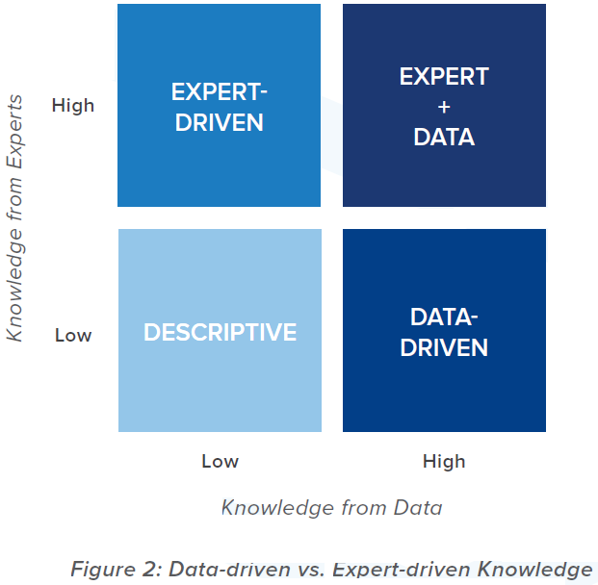
4 Levels of Knowledge Model
Computationally encode expert opinions and assumptions.
Combine deductive and inductive reasoning to determine causes from measured effects
Sources of knowledge whether data or expert are independent. Combine data- and expert-driven approaches to maximize insight and value.
Expert-driven approaches is preferred if:
an accepted premise
the data is filtered
poorly represents the full situation
Data –driven modeling:
is inductive
graded superior to expert-driven ones.
allow unknown rules or relationships to be discovered from the data
are less susceptible to the biases and misconceptions common to human reasoning.
Deterministically summarize data
Induce new rules or formulas from data.
Notes:
These sources of knowledge – data or expert – are independent; a modeling technology can rely on either or both, to varying degree.
Though there are potential pitfalls at all levels, we believe the accuracy and quality of the answer improves as you move up the levels. We grade data-driven inductive modeling approaches superior to expert-driven ones, as the inductive techniques allow unknown rules or relationships to be discovered from the data and are less susceptible to the biases and misconceptions common to human reasoning. On the other hand, expert-driven approaches are preferred if the data is filtered or poorly represents the full situation. Ideally, it is best to employ analytic approaches which combine both expert-driven and data-driven modeling.

Slide 85
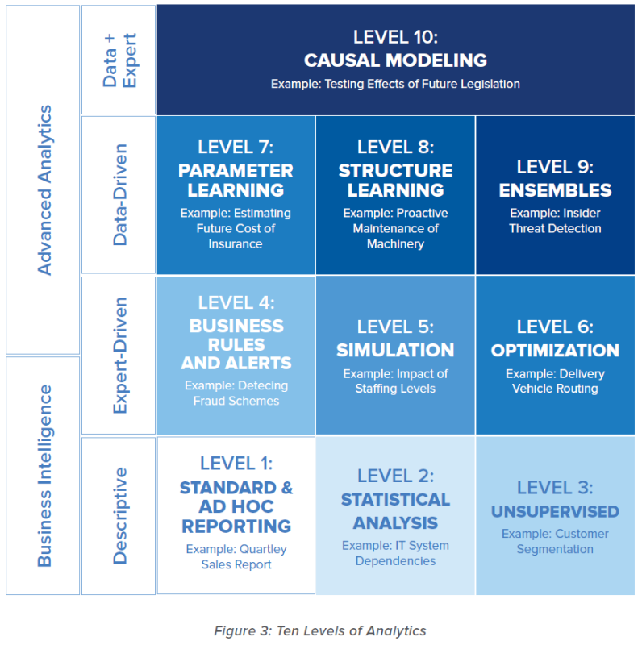
10 Levels of Analytics
complexity and power
complexity and power
Ten Levels of Analytics
https://www.elderresearch.com/consulting-services/ten-levels-of-analytics
Notes:
This framework can be used to help teams understand where they are operating and what approaches are best for the analytic question and challenge they are facing.
The upward dimension changes when moving from simple Descriptive analytic tasks to more Predictive and Prescriptive, and from Business Intelligence to Advanced Analytics. The position from left to right reflects the intensity and complexity within a category. This framework can be used to help teams understand where they are operating and what approaches are best for the analytic question and challenge they are facing. As one moves up the levels, the complexity and power of analytics increases. This makes possible greater accuracy when it’s done right, but more danger if done wrong!

Slide 86
Analytic Techniques and their Disciplines
Simulation
Fourier Transformations
Optimization
Forecasting
Operations Research
K Means Clustering
Neural Networks
Graph Theory
Linear, Logistic Regression & GLM
Harmonic Analysis
Time Series Analysis
Decision Trees
Hierarchical Clustering
Link Analysis
Monte Carlo
ANOVA
Data Mining
Principal Components
Statistics
Association Rules
Factor Analysis
Visualization
Correlation
Querying
Business Intelligence
OLAP
SQL
*Diagram developed by John Elder and Dustin Hux

Slide 87
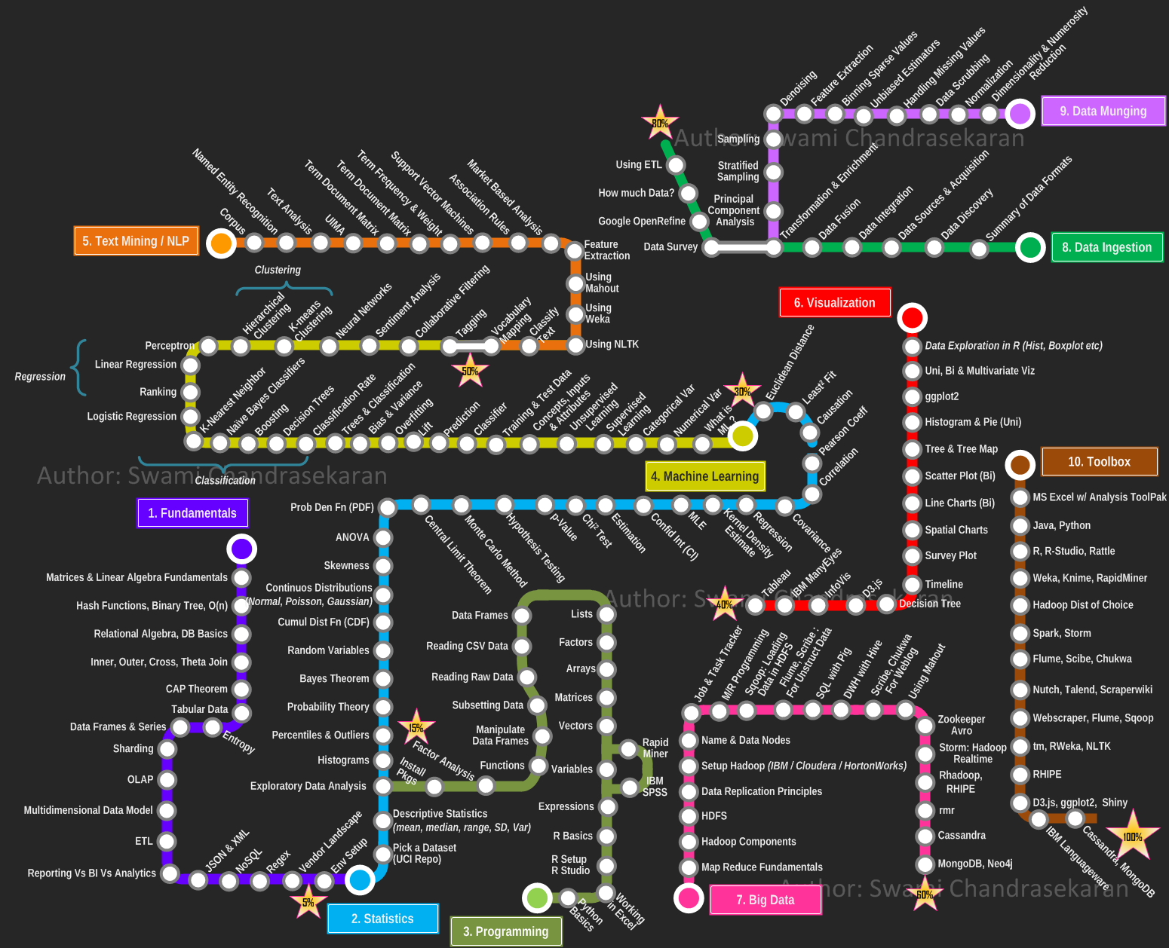

Slide 88
Module 4: R for Data Science

Slide 89
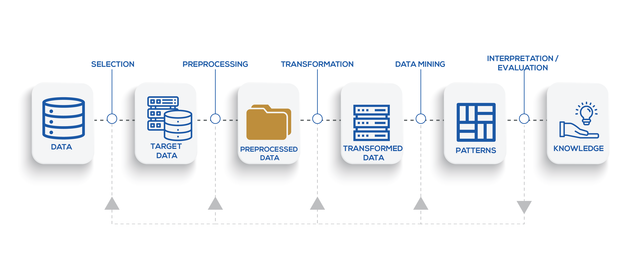
Knowledge Discovery Process

Slide 90
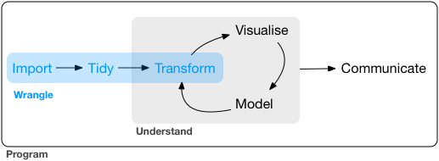
Notes:
1. Source data ➡️
Experimental data
External data sets
Manually collected data and meta data
2. Intermediate ➡️
Derived data
Computatation
Manual curation
Tidy data - Definitions
Principles of tidy data to structure data
Find errors in existing data sets
Structure data
Some reshaping data with tidyr
- Comments
Cleaning data also requires dplyr
tidyr and dplyr are intertwined
Focus on tidy data
Introduction of tidyr ways
Other tidyr functionality will be covered in dplyr and broom lectures.
3. Analysis ➡️
Exploratory analysis
Statistical models
Hypothesis testing
4. Manuscript
Can you reproduce your work?
All numbers
Summaries
Images

Slide 91
Learning objectives of this module:
Introduction to Data Analysis
Learn the basic vocabulary of dplyr
Exercise commands
Translating questions into data manipulation statements
Visit the tidyr package
Learn the why and how of Exploratory Data Analysis (EDA).

Slide 92
Data Wrangling
Importation Cleaning Structuring
Missing Data
Dates & Time HTML Parsing
String Processing Text Mining
Notes:
Introduction to Data Analysis
Data analysis can be divided into three parts
Extraction: First, we need to collect the data from many sources and combine them. - dplyr
Transform: This step involves the data manipulation. Once we have consolidated all the sources of data, we can begin to clean the data.
Visualize: The last move is to visualize our data to check irregularity.
Useful data manipulation packages
The dplyr library is fundamentally created around four functions to manipulate the data and five verbs to clean the data. After that, we can use the ggplot library to analyze and visualize the data.
the basic tools needed to make your data behave, including data reshaping, regular expressions and other text manipulation tools.
Select
Mutate
work with “tibbles” instead of R’s traditional data.frame. Tibbles are data frames, but they tweak some older behaviours to make life a little easier.

Slide 93
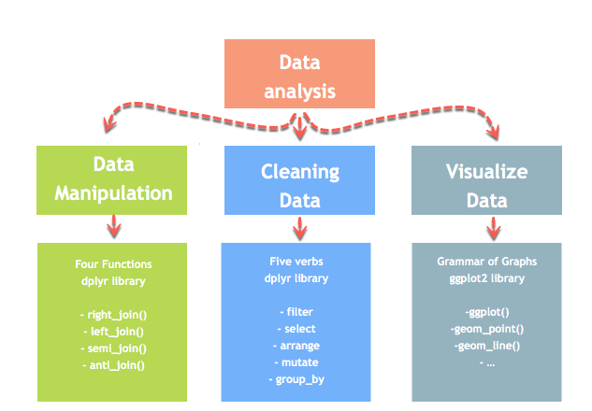
Data Wrangling – Dplyr Package
Notes:
One of the most time consuming steps in any data analysis is cleaning the data and getting it into a format that allows analysis. In this section, you will learn all about tools in R that make data wrangling.
The dplyr library is fundamentally created around four functions to manipulate the data and five verbs to clean the data. After that, we can use the ggplot library to analyze and visualize the data.
dplyr supersedes previous packages from Hadley Wickham
reshape
reshape2
plyr
Do not use these packages! All functionality can be found in dplyr or tidyr.

Slide 94
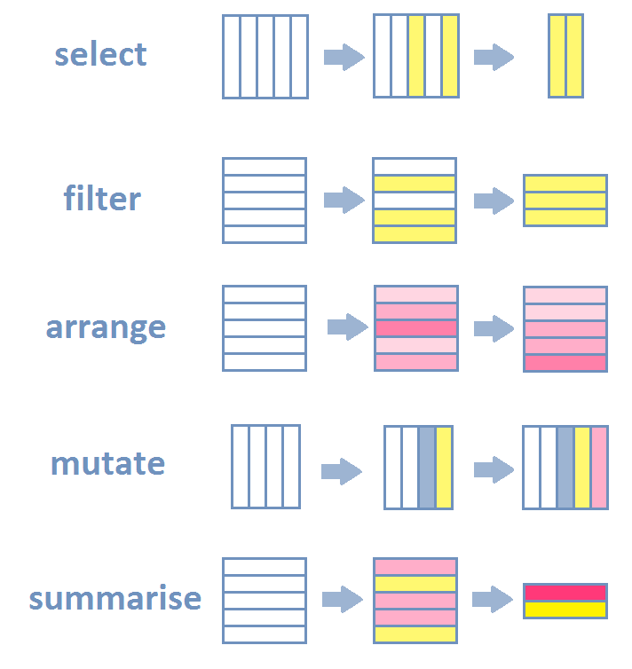
Inspect your tibble (glimpse())
Select specific columns (select())
Filter out a subset of rows (filter())
Change or add columns (mutate())
Group observations by a grouping variable (group_by())
Get a summary (in particular per group) (summarise())
Join two distinct tibbles by a common column (left_join(), right_join() and full_join())
Source: http://perso.ens-lyon.fr/lise.vaudor/dplyr/

Slide 95
Tame Data
Tidy Data
Variables
Gather()
Observations
Values
Notes:
The wide format is generally untidy but found in the majority of datasets
The wide format makes computation on columns sometimes easier
Tame data does not equal tidy data
Each variable forms a column
Each observation forms a row
Each type of observational unit forms a table
See the paper Tidy Data by Hadley Wickham in Journal of Statistical Software (2014)

Slide 96
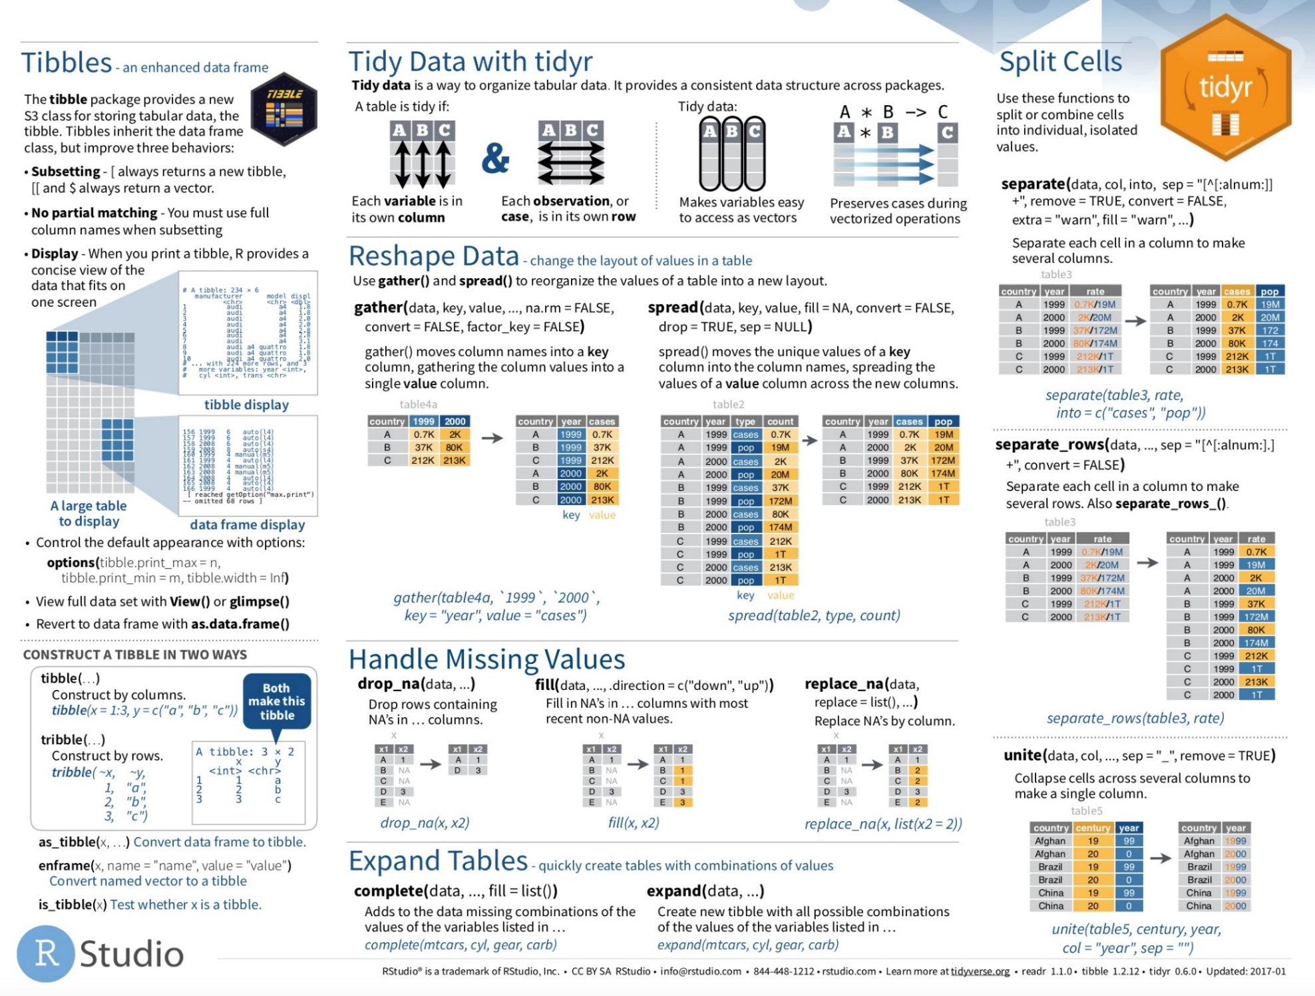
http://tidyr.tidyverse.org/ vignette("tidy-data")
Notes:
Tidyr functionality (cheetsheets)
- Tidy data coverage
Basic column-wise manipulation
now
Reshaping operations
after dplyr
Nesting and advanced collapsing operations
after broom

Slide 97
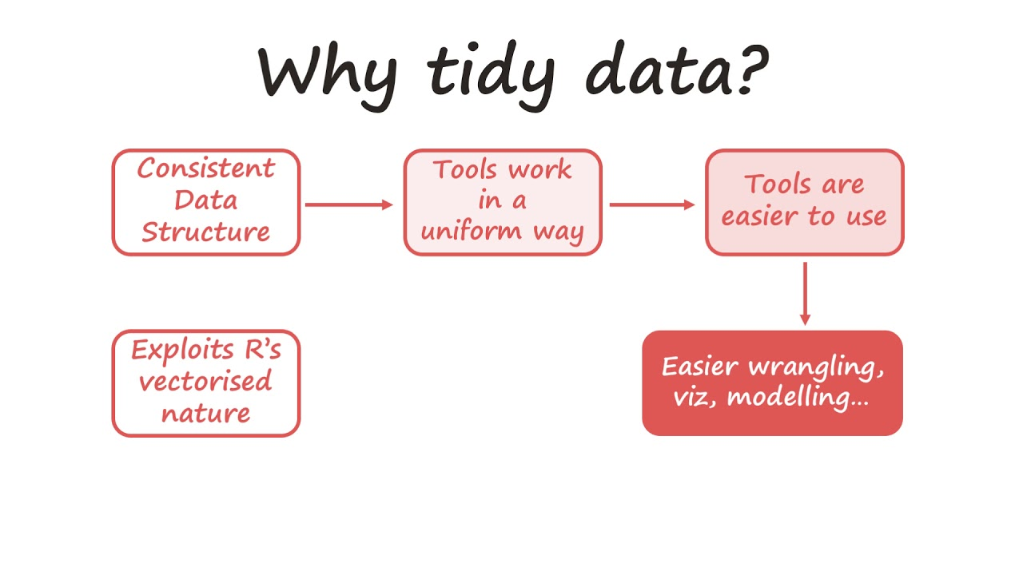
Notes:
- Data wrangling is the process of cleaning messy and complex data sets to enable convenient consumption and further analysis. T
his is a very important and time taking process in data science. R has an extensive library of tools for database manipulation and wrangling.
- Some of the popular packages for data manipulation in R include:
dplyr Package – Created and maintained by Hadley Wickham, dplyr is best known for its data exploration and transformation capabilities and highly adaptive chaining syntax.
- data.table Package – It allows for faster manipulation of data set with minimum coding. It simplifies data aggregation and drastically reduces the compute time.
- readr Package – ‘readr’ helps in reading various forms of data into R. By not converting characters into factors it performs the task at 10x faster speed.
Problem –
Column headers are values, not variable names (gather)
Multiple variables stored in one column (separate)
Variables are stored in both rows and columns (gather-spread)
Repeated observations (nest or table)
Multiple types in one table (dplyr data transformation)
One type in multiple tables (dplyr, combine into single table)

Slide 98
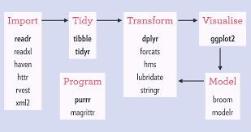

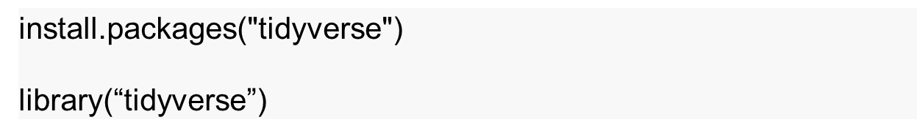
https://www.tidyverse.org/
https://github.com/rstudio/master-the-tidyverse/archive/master.zip
Notes:
An opinionated collection of R packages designed for data science.
All packages share an underlying design philosophy, grammar, and data structures.
Visualize data with R's ggplot2 package
Wrangle data with R's dplyr package
Fit models with base R
Document your work reproducibly with R Markdown

Slide 99
Tidy Data
See the paper Tidy Data by Hadley Wickham in Journal of Statistical Software (2014)
https://github.com/rstudio/master-the-tidyverse/archive/master.zip
All material is permissively licensed under CC-BY-SA 4.0.
Notes:
Putting this into Practice

Slide 100
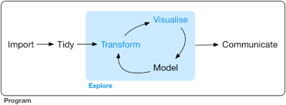

Slide 101
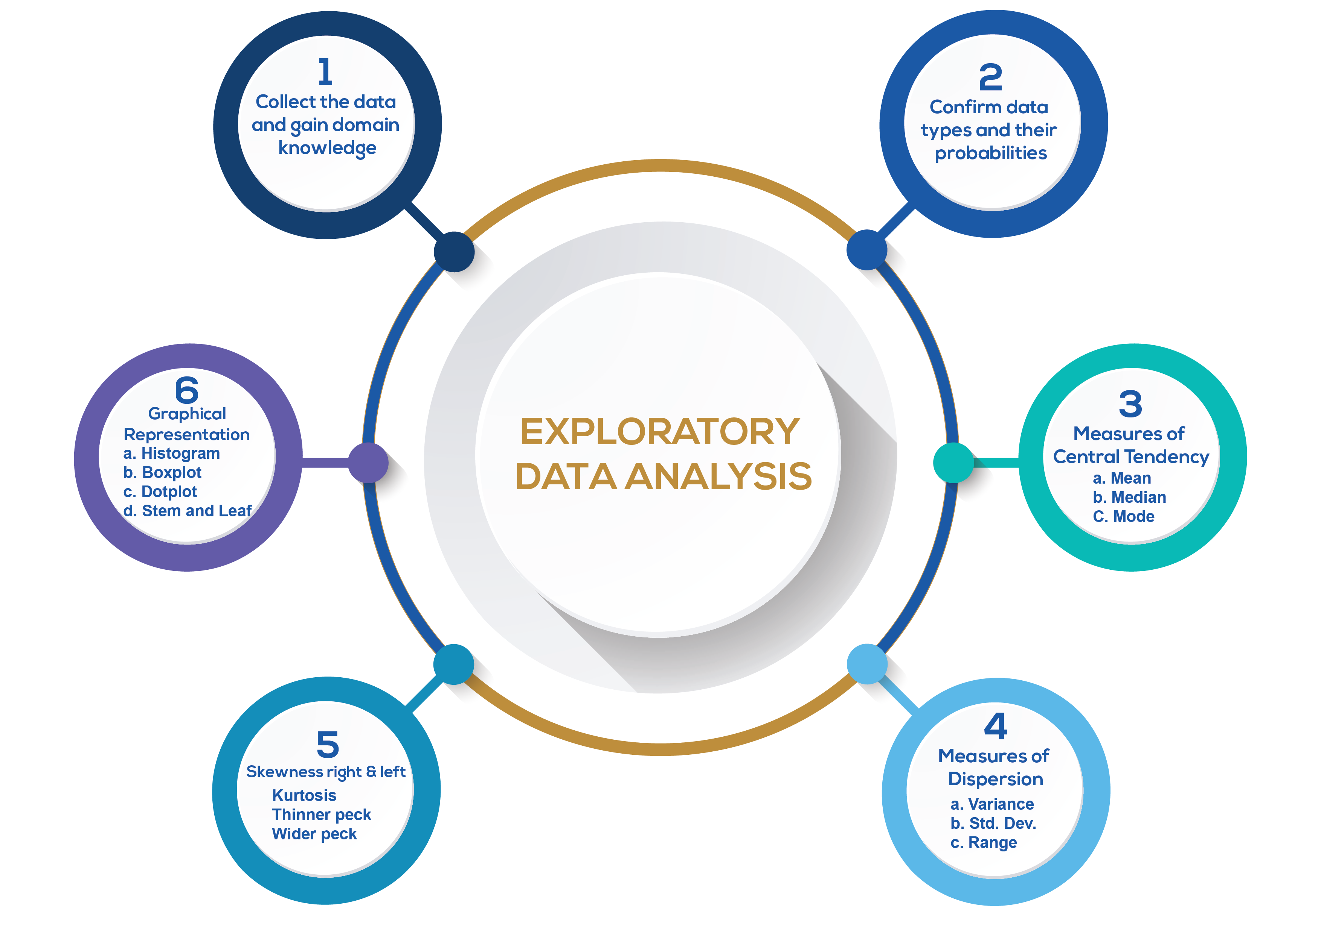

Slide 102
“Get to Know" the dataset
Doing so upfront will make the rest of the project much smoother, in 3 main ways:
You’ll gain valuable hints for Data Cleaning.
You’ll think of ideas for Feature Engineering.
You’ll get a "feel" for the dataset, which will help you communicate results and deliver greater impact.
EDA should be quick, efficient, and decisive... not long and drawn out!
You see, there are infinite possible plots, charts, and tables, but you only need a handful to "get to know" the data well enough to work with it.
Notes:
You’ll gain valuable hints for Data Cleaning (which can make or break your models).
You’ll think of ideas for Feature Engineering (which can take your models from good to great).
You’ll get a "feel" for the dataset, which will help you communicate results and deliver greater impact.

Slide 103
What is EDA?
An approach for data analysis that employs a variety of techniques
Maximize insight into a data set
Uncover underlying structure
Extract important variables
Detect outliers and anomalies
Test underlying assumptions
Develop parsimonious models and
Determine optimal factor settings
Notes:
EDA is an approach that….
Postpones the usual assumptions about what kind of model the data follow with the more direct approach of allowing the data itself to reveal its underlying structure and model.
A philosophy as to how to dissect a dataset; what we look for; how we look and how we interpret.
It is true EDA heavily uses the collection of techniques that are called “statistical graphics”, but it is not identical to statistical graphics per se.
EDA in a data science context refers to the critical process of performing initial investigations on data so as to discover patterns,to spot anomalies,to test hypothesis and to check assumptions with the help of summary statistics and graphical representations.

Slide 104
EDA is a data approach.
The EDA sequence is:
Problem => Data => Analysis=> Model=> Conclusions
As opposed for a classical approach:
Problem => Data => Model=> Analysis=> Conclusions
Notes:
Model
Does not impose deterministic or probabilistic models on the data
Focus
Focus is on the data
Focus is on the structure, outliers and models suggested by the data
Techniques
Graphical in nature with a few quantitative techniques
Data Treatment
Make little to no assumptions – present and show the data

Slide 105
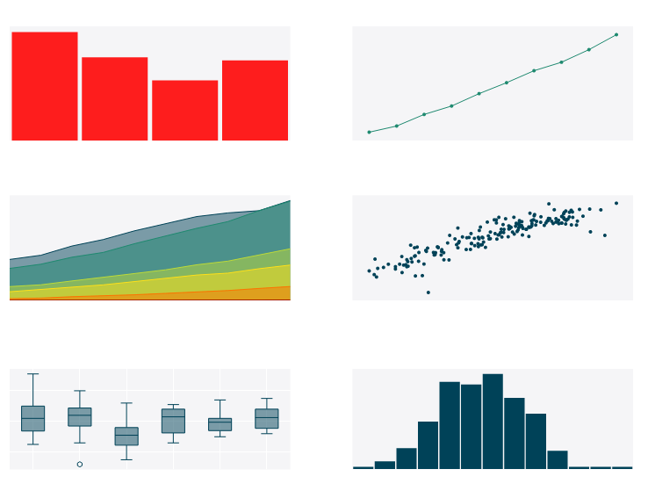
EDA Techniques are generally graphical
Notes:
Scatter plots
Character plots
Box plots
Histograms
Probability plots
Residual plots
Mean plots
Such inconsiderate behavior can lead to:
skewed data, with outliers and too many missing values and, therefore, some sad outcomes for the project:
generating inaccurate models;
generating accurate models on the wrong data;
choosing the wrong variables for the model;
inefficient use of the resources, including the rebuilding of the model.

Slide 106
EDA is majorly performed using the following methods:
Univariate visualization – provides summary statistics for each field in the raw data set
Bivariate visualization – is performed to find the relationship between each variable in the dataset and the target variable of interest
Multivariate visualization – is performed to understand interactions between different fields in the dataset
Dimensionality reduction – helps to understand the fields in the data that account for the most variance between observations and allow for the processing of a reduced volume of data.
Notes:
https://cran.r-project.org/web/packages/dlookr/vignettes/EDA.html

Slide 107
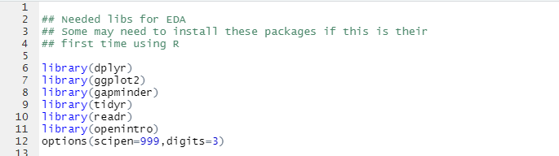
Useful Packages

Slide 108

EDA of Categorical Data

Slide 109
Example: Coronvirus
https://www.kaggle.com/xordux/india-corona-severity-zones
The zones are:
Green Zone: Least impacted zone, A district will be considered under green zone if there has been no confirmed cases of COVID-19 so far or there is no reported case since last 21 days in the district.
Orange Zone: Districts that do not have enough confirmed cases to meet the ‘red zone’, but are being seen as potential hotspots, are part of the ‘orange zone’. A Red Zone can be categorised as a Orange Zone if no new confirmed case is reported there for 14 consecutive days.
Red Zone: Districts reporting a large number of cases or high growth rates. Inclusion criteria for Red Zone:
Highest case-load districts contributing to over 80 percent of cases in India, or
Highest case-load districts contributing to more than 80 percent of cases for each state in the country, or
Districts with doubling rate at less than four days (calculated every Monday for last seven days, to be determined by the state government).

Slide 110
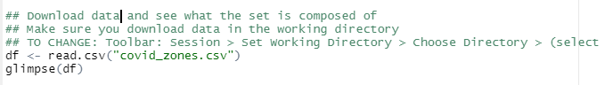
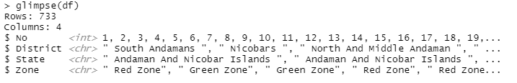
Upload Data

Slide 111
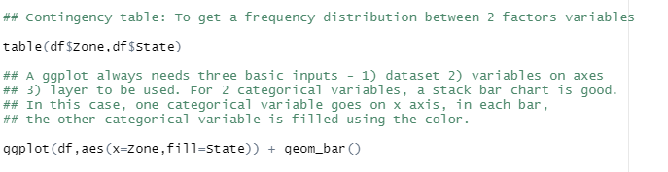
Contingency Table

Slide 112
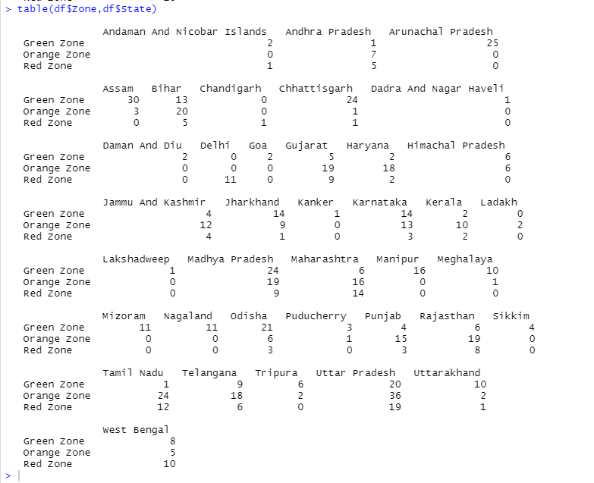
Output for Contingency Table

Slide 113
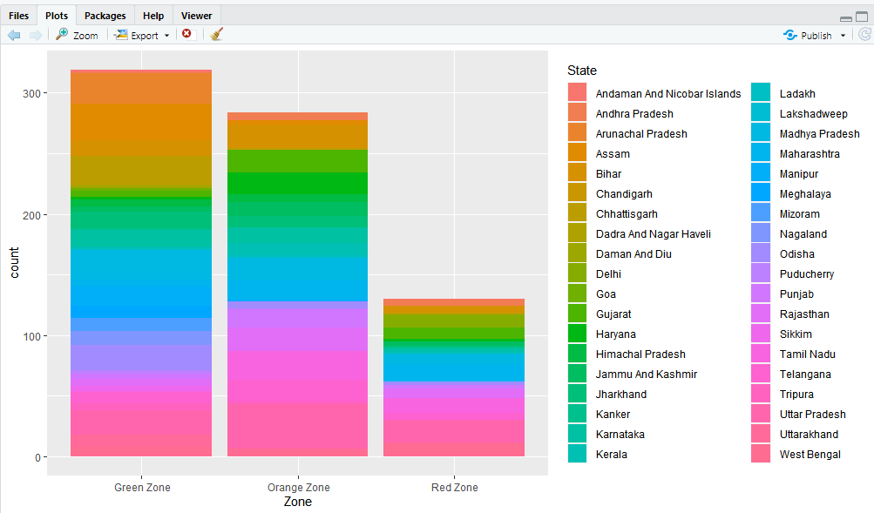
Output for ggplot()

Slide 114
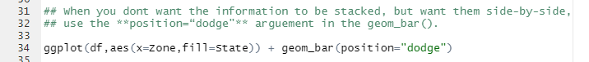
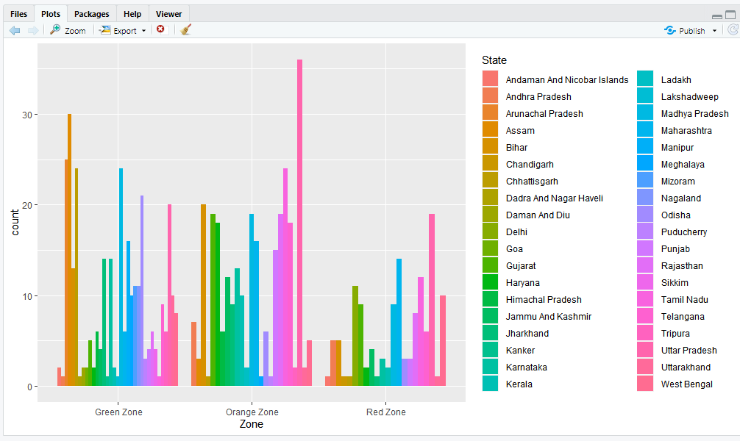
Side-by-Side?

Slide 115
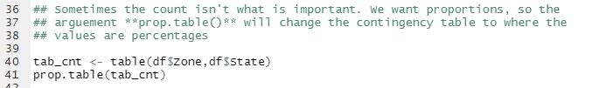
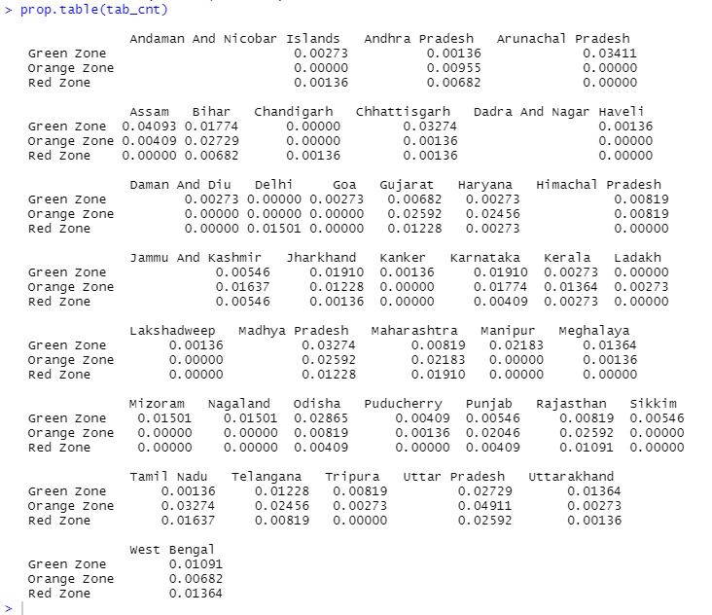
Proportions
Output

Slide 116
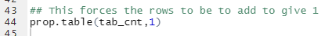
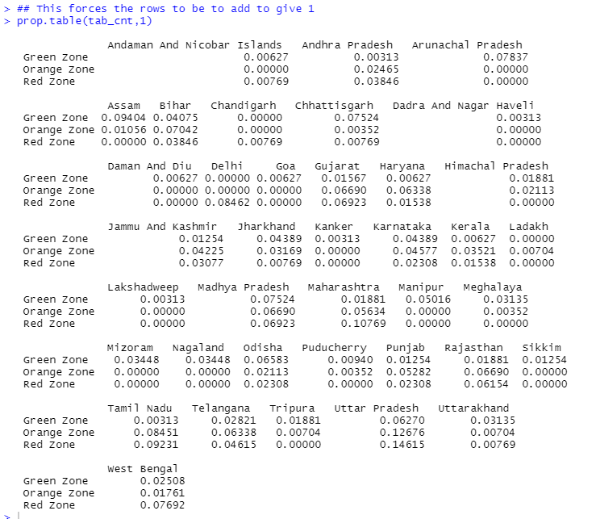
Proportions (con’t)

Slide 117
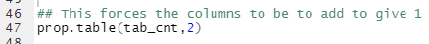
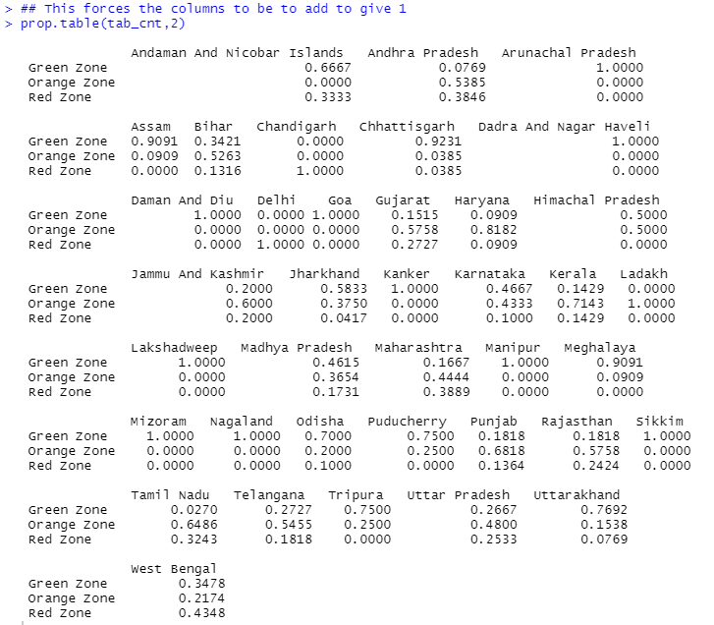
Proportions (con’t)

Slide 118
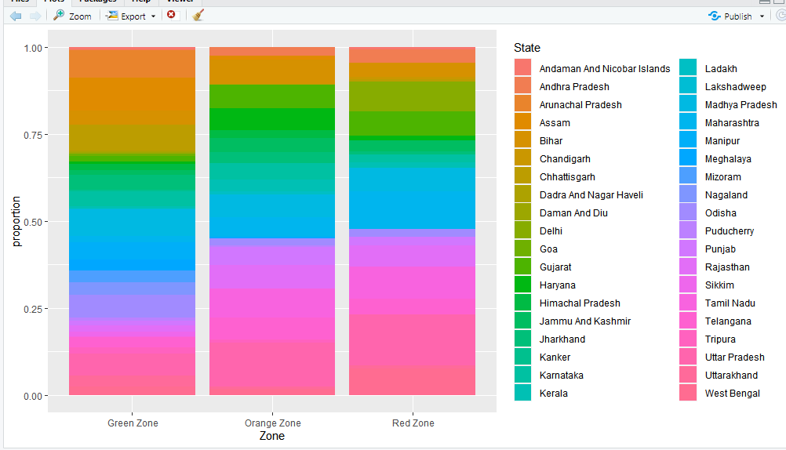
100% stack chart, conditioned on Zone

Slide 119
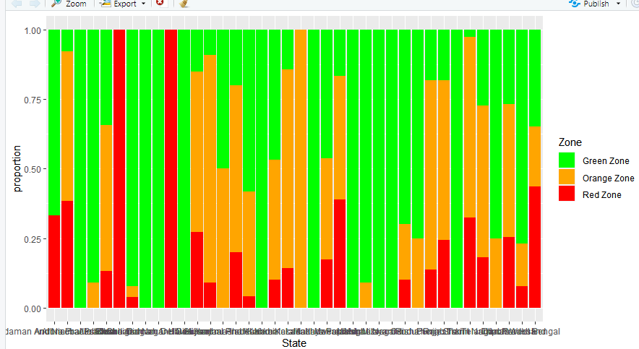
100% stacked bar chart, conditioned on State
Let’s Clean the labels up!

Slide 120



Slide 121


Marginal Distribution

Slide 122

Distribution against one variable

Slide 123
EDA of Numeric Data

Slide 124
Example: Air Quality
https://stat.ethz.ch/R-manual/R-devel/library/datasets/html/airquality.html
Daily air quality measurements in New York, May to September 1973.
Daily readings of the following air quality values for May 1, 1973 (a Tuesday) to September 30, 1973.
Ozone: Mean ozone in parts per billion from 1300 to 1500 hours at Roosevelt Island
Solar.R: Solar radiation in Langleys in the frequency band 4000–7700 Angstroms from 0800 to 1200 hours at Central Park
Wind: Average wind speed in miles per hour at 0700 and 1000 hours at LaGuardia Airport
Temp: Maximum daily temperature in degrees Fahrenheit at La Guardia Airport.
Month: Numeric value between 1-12
Day: Numeric value between 1-31

Slide 125


Upload Numeric Data

Slide 126


Data Cleaning
Output

Slide 127

Dotplot

Slide 128

Histogram

Slide 129

Density plot

Slide 130

Boxplot

Slide 131

Boxplot (coord_flipped)

Slide 132

Faceted plots

Slide 133
Module 5: Statistics

Slide 134

Notes:
1. Descriptive statistics merely “describes” research and does not allow for conclusions or predictions.
2.Inferential statistics makes it possible for the researcher to arrive at a conclusion and predict changes that may occur regarding the area of concern.
3.Descriptive statistics usually operates within a specific area that contains the entire target population.
4.Inferential statistics usually takes a sample of a population, especially if the population is too large to conduct research on.
Read more: Difference Between Descriptive and Inferential Statistics | Difference Between http://www.differencebetween.net/language/words-language/difference-between-descriptive-and-inferential-statistics/#ixzz6DcPfLgV5

Slide 135

Notes:
Statistics for Model building and evaluation

Slide 136

Inferential Statistics
Notes:
descriptive statistics are used to summarize a sample or information about the sample. Inferential statistics, on the other hand, are used to make inferences or g
Inferential statistics are used to test hypotheses about the relationship between the independent and the dependent variables.
Inferential statistics allow you to test your hypothesis
When you get a statistically significant result using inferential statistics, you can say that it is unlikely (in social sciences this is 5%) that the relationship between variables is due to chance.
eneralizations about the broader population.

Slide 137

Sampling
Notes:
Probability Sampling
The main difference between a population and sample has to do with how observations are assigned to the data set.
A population includes all of the elements from a set of data.
A sample consists one or more observations drawn from the population.
Depending on the sampling method, a sample can have fewer observations than the population, the same number of observations, or more observations. More than one sample can be derived from the same population.

Slide 138
The sampling process comprises several stages:
Define the population of concern
Specify a sampling frame, a set of items or events possible to measure
Specify a sampling method for selecting items or events from the frame
Determine the sample size
Implement the sampling plan
Sample and collect data

Slide 139

Notes:
imple random sampling is a completely random method of selecting subjects. These can include assigning numbers to all subjects and then using a random number generator to choose random numbers. Classic ball and urn experiments are another example of this process (assuming the balls are sufficiently mixed). The members whose numbers are chosen are included in the sample.
Stratified Random Sampling involves splitting subjects into mutually exclusive groups and then using simple random sampling to choose members from groups.
Systematic Sampling means that you choose every “nth” participant from a complete list. For example, you could choose every 10th person listed.
Cluster Random Sampling is a way to randomly select participants from a list that is too large for simple random sampling. For example, if you wanted to choose 1000 participants from the entire population of the U.S., it is likely impossible to get a complete list of everyone. Instead, the researcher randomly selects areas (i.e. cities or counties) and randomly selects from within those boundaries.
Multi-Stage Random sampling uses a combination of techniques.

Slide 140

Notes:
There are various sampling methods. The one chosen will depend on a number of factors (such as time, money etc.).
Probability Sampling:
Sample has a known probability of being selected.
Individuals are sampled independently of each other.
Known as random sampling
Non-probability (Judgement) Sampling:
Convenience sampling (voluntary response surveys)
Refers to when researchers take whatever individuals happen to be easiest to access as participants in a study
Simple Random Sampling (SRS)
Stratified Sampling
Cluster Sampling
Systematic Sampling
Multistage Sampling (above methods are combined in stages)
stratified sampling
Reduces sampling error by gaining greater control over the composition of the sample
Ensures small group within a population is adequately represented in a sample
Con – must have data on the characteristics of the population
cluster sampling
Used on very large sample, not necessary to have data on important variables for entire population.
Ordinally used to reduce costs
Con – produces less representative samples
systematic
More practical with time and resources compared to simple random sampling
Can be bias if the sample frame from which the sample is selected is ordered is some kind of systematic fashion that influences composition

Slide 141
Generating random data
sample(x, size, replace = FALSE, prob = NULL)
> set.seed(1)
> sample(1:6, 10, replace=TRUE)
> sample(1:6, 10, replace=TRUE)
> set.seed(123)
> index <- sample(1:nrow(iris), 5)
> index
> iris[index, ]
Notes:
Syntax for Sample function in R
set.seed() to control random samples: you will want to exert some control over the random samples that R produces from sampling functions.
If you don’t specify the replace argument, R will assume that you are sampling without replacement.
If you want to sample with replacement, use the replace = TRUE argument:
# Draw 30 samples from the integers 1:5 with replacement
sample(x = 1:5, size = 10, replace = TRUE)
Simulate a positive or negative diagnosis
sample(x = c(“P", “N"), prob = c(.8, .2), # Make the coin biased for Heads size = 10, replace = TRUE)
# Create chest with the 100 coins
chest <- c(rep("gold", 20), rep("silver", 30), rep("bronze", 50))
# Draw 10 coins from the chest sample(x = chest, size = 10)

Slide 142

Simple random distributions:
1. Normal (aka Gaussian): bell-shaped, and has two parameters: a mean and a standard deviation.
2. Uniform: everything between its lower and upper bounds are equally likely to occur.
# 5 samples from Uniform dist with bounds at 0 and 1
runif(n = 5, min = 0, max = 1)
# 10 samples from Uniform dist with bounds at -75 and +75
runif(n = 5, min = -75, max = 75)
Notes:
The Normal distribution is bell-shaped, and has two parameters: a mean and a standard deviation.
# 5 samples from a Normal dist with mean = 0, sd = 1 rnorm(n = 5, mean = 0, sd = 1) ## [1] -0.0046 -0.0016 1.2226 1.2509 1.8195 # 3 samples from a Normal dist with mean = -10, sd = 15 rnorm(n = 3, mean = -10, sd = 15)
# 5 samples from Uniform dist with bounds at 0 and 1
runif(n = 5, min = 0, max = 1)
# 10 samples from Uniform dist with bounds at -100 and +100
runif(n = 10, min = -100, max = 100)

Slide 143
Sampling Challenges
Sampling error - discrepancies between the sample and the population on a certain parameter that are due to random differences; no fault of the researcher.
Systematic error - difference between the sample and the population that is due to a systematic difference between the two rather than random chance alone.
Response rate - sample can become self-selecting, and that there may be something about people who choose to participate in the study that affects one of the variables of interest.
Coverage error - refers to the fact that sometimes researchers mistakenly restrict their sampling frame to a subset of the population of interest
*The more participants a study has, the less likely the study is to suffer from sampling error.
Notes:
Where do you see these challenges in your data?
Survey
Lab reports
nonsampling errors
Using an incomplete population
Nonresponse
Interviewer errors
Misrepresented answers
Mistakes in recording or entering data
Questionnaire design
Wording of questions
Order of questions, words, and responses

Slide 144

Notes:
As the large of n, the closer to the sample mean.
1. The distribution of sample means seems to have the same center as the distribution of individual values, and
2. The variation in the distribution of sample means is much less than the original distribution. (In other words, the distribution of sample means is much skinnier than the distribution of individual values.)
Z value is a measure of standard deviation i.e. how many standard deviation away from mean is the observed value
Z= x (value) – mean / (std dev)
Here X is the point on the curve, μ is mean of the population and σ is standard deviation of population.
In case, the population distribution is not normal, we’d resort to Central Limit Theorem.

Slide 145
Motivation . . .
The purpose of hypothesis testing is to determine whether there is enough statistical evidence in favor of a certain belief, or hypothesis, about a parameter.

Slide 146
It is a 7-step process:
Make Assumptions.
Take an initial position.
Determine the alternate position.
Set acceptance criteria
Conduct fact based tests.
Evaluate results. Does the evaluation support the initial position? Are we confident that the result is not due to chance?
Reach one of the following conclusion: Reject the original position in favor of alternate position or fail to reject the initial position.
Notes:
Let’s recall…

Slide 147

Notes:
Under the null hypothesis of µ = 0, the sampling distribution of the mean has a mean of 0 and a standard deviation of sigma/sqrt(n).
Under the alternative hypothesis of µ = delta, the sampling distribution of the mean has a mean of delta and the standard deviation is equal to that of the null distribution.
Sigma/sqrt(n) is called the standard error of the mean, which is simpler than saying the standard deviation of the sampling distribution of the sample mean.

Slide 148
Recall the Central Limit Theorem:
Using this, we determine if our assumption for the null hypothesis (H0) is reasonable or not. If it is unlikely, by the Rare Event rule, our hypothesis is probably incorrect (i.e. reject H0).
In general, we use the following: Source: corporatefinanceinstitute.com
If the test sample yields an unlikely result, it is probably incorrect (reject H0)
If the test sample yields a likely result, it is probably correct (fail to reject H0)
Notes:
What is one of the most important and core concepts of statistics that enables us to do predictive modeling, and yet it often confuses aspiring data scientists?
The central limit theorem states that the sampling distribution of the mean approaches a normal distribution, as the sample size increases. ... Therefore, as a sample size increases, the sample mean and standard deviation will be closer in value to the population mean and standard deviation.
First, draw groups of students at random from the class. We will call this a sample. We’ll draw multiple samples, each consisting of 30 students.
Calculate the individual mean of these samples
Calculate the mean of these sample means
This value will give us the approximate mean weight of the students in the science department
Additionally, the histogram of the sample mean weights of students will resemble a bell curve (or normal distribution)
This, in a nutshell, is what the central limit theorem is all about.

Slide 149
There is an extremely close relationship between confidence intervals and hypothesis testing.
When a 95% confidence interval is constructed, all values in the interval are considered plausible values for the parameter being estimated. Values outside the interval are rejected as relatively implausible.
The confidence interval tells you more than just the possible range around the estimate. It also tells you about how stable the estimate is.
If exact p-value is reported, then the relationship between confidence intervals and hypothesis testing is very close. However, the objective of the two methods is different: Hypothesis testing relates to a single conclusion of statistical significance vs. no statistical significance.

Slide 150

What is Significance Level?
This 5% is called Significance Level also known as alpha level (symbolized as α). It means that if random chance probability is less than 5% then we can conclude that there is difference in behavior of two different population. (1- Significance level) is also known as Confidence Level i.e. we can say that I am 95% confident that it is not driven by randomness.

Slide 151

Were you right ? ...
Notes:
Conclusions are sentence answers which include whether there is enough evidence or not (based on the decision), the level of significance, and whether the original claim is supported or rejected. Conclusions are based on the original claim, which may be the null or alternative hypotheses. The decisions are always based on the null hypothesis
I errors
Occurs when the null hypothesis is true, but is rejected. Conclusion is there is an association when there actually is none.
A false positive, is asserting something as true when it is actually false.
Type II errors
Occurs when the null hypothesis is false, but erroneously fails to be rejected. Conclusion is there is no association when there actually is one.
A false negative, is where a test result indicates that a condition failed, while it actually was successful.

Slide 152
Conclusions are sentence answers which include whether there is enough evidence or not (based on the decision), the level of significance, and whether the original claim is supported or rejected. Conclusions are based on the original claim, which may be the null or alternative hypotheses. The decisions are always based on the null hypothesis
 | Original Claim
Decision | H₀ "REJECT" | H₁ "SUPPORT"
Reject H₀ "SUFFICIENT" | There is sufficient evidence at the alpha level of significance to reject the claim that (insert original claim here) | There is sufficient evidence at the alpha level of significance to support the claim that (insert original claim here)
Fail to reject H₀ "INSUFFICIENT" | There is insufficient evidence at the alpha level of significance to reject the claim that (insert original claim here) | There is insufficient evidence at the alpha level of significance to support the claim that (insert original claim here)

Slide 153

Notes:
Conduct when a priori (knowledge that proceeds from theoretical deduction rather than from observation) the researcher does not know whether the population mean is likely to increase or decrease relative to the (null) hypothesized mean.
The significance level is now split between the upper and lower tails of the null hypothesis distribution and correspondingly both tails comprise the rejection region.
There are two forms of research hypothesis. The critical or rejection region can be one side of the distribution or both sides of the distribution depending on the nature of the research hypothesis. Directional research hypothesis or one tail test has one critical region. On the contrary, the Non-directional research hypothesis or two tail test has two rejection regions on both sides of the distribution.

Slide 154

Statistical learning emphasizes the models and their interpretability, and precision and uncertainty.
The most common statistical tests include:
Chi-square
T-test
ANOVA
Correlation
Linear Regression

Slide 155

The R function chisq.test() can be used as follow: chisq.test(x, p) - statistic: the value the chi-squared test statistic. - parameter: the degrees of freedom - p.value: the p-value of the test - observed: the observed count - expected: the expected count
Notes:
Do in R
tulip <- c(81, 50, 27)
res <- chisq.test(tulip, p = c(1/2, 1/3, 1/6)) <- probabilities
Res
Chi-squared test for given probabilities data: tulip X-squared = 0.20253, df = 2, p-value = 0.9037

Slide 156

Analysis of Variance (ANOVA) is a statistical technique, commonly used to study differences between two or more group means.
Notes:
When there are two independent variables, we will need to use two way ANOVA rather than one-way ANOVA
ANOVA test determines the difference in mean between two or more independent groups.
The ANOVA test can tell if the three groups have similar performances.
To clarify if the data comes from the same population, you can perform a one-way analysis of variance (one-way ANOVA hereafter).
This test, like any other statistical tests, gives evidence whether the H0 hypothesis can be accepted or rejected.

Slide 157
Student’s t-test: Commands and explanation
t.test(data.1, data.2) – The basic method of applying a t-test is to compare two vectors of numeric data.
var.equal = FALSE – If the var.equal instruction is set to TRUE, the variance is considered to be equal and the standard test is carried out. If the instruction is set to FALSE (the default), the variance is considered unequal and the Welch two-sample test is carried out.
mu = 0 – If a one-sample test is carried out, mu indicates the mean against which the sample should be tested.
alternative = “two.sided” – It sets the alternative hypothesis. The default value for this is “two.sided” but a greater or lesser value can also be assigned. You can abbreviate the instruction.
conf.level = 0.95 – It sets the confidence level of the interval (default = 0.95).
paired = FALSE – If set to TRUE, a matched pair T-test is carried out.
t.test(y ~ x, data, subset) – The required data can be specified as a formula of the form response ~ predictor. In this case, the data should be named and a subset of the predictor variable can be specified.
subset = predictor %in% c(“sample.1”, sample.2”) – If the data is in the form response ~ predictor, the two samples to be selected from the predictor should be specified by the subset instruction from the column of the data.

Slide 158

Notes:
It is helpful to decide the input variables and the outcome variables. For example, in a clinical trial the input variable is the type of treatment - a nominal variable - and the outcome may be some clinical measure perhaps Normally distributed. The required test is then the t-test (Table 2). However, if the input variable is continuous, say a clinical score, and the outcome is nominal, say cured or not cured, logistic regression is the required analysis. A t-test in this case may help but would not give us what we require, namely the probability of a cure for a given value of the clinical score. As another example, suppose we have a cross-sectional study in which we ask a random sample of people whether they think their general practitioner is doing a good job, on a five point scale, and we wish to ascertain whether women have a higher opinion of general practitioners than men have. The input variable is gender, which is nominal. The outcome variable is the five point ordinal scale. Each person's opinion is independent of the others, so we have independent data. From Table 2 we should use a χ² test for trend, or a Mann-Whitney U test with a correction for ties (N.B. a tie occurs where two or more values are the same, so there is no strictly increasing order of ranks – where this happens, one can average the ranks for tied values).

Slide 161


Slide 162
Module 5: Machine Learning
Notes:
At some point in data science, a programmer may need to train the algorithm and bring in automation and learning capabilities to make predictions possible. R provides ample tools to developers to train and evaluate an algorithm and predict future events.
Thus, R makes machine learning (a branch of data science) lot more easy and approachable.
The list of R packages for machine learning is really extensive. R machine learning packages include MICE (to take care of missing values), rpart & PARTY (for creating data partitions), CARET (for classification and regression training), randomFOREST (for creating decision trees) and much more.

Slide 163

Notes:
The course aims at providing an accessible introduction to various machine learning methods and applications in R. The core of the courses focuses on unsupervised and supervised methods.

Slide 164
Applying the Data Analytic Lifecycle
In a typical Data Analytical Problem – you would have gone through:
Phase 1 – Discovery – have the problem framed
Phase 2 – Data Preparation – have the data prepared
Now you need to plan the model and determine the method to be used.
Phase 3 – Model Planning
Have do people generally solve this problem with the kind of data and resources I have?
Does this work well enough? Or do I need to come up with something new?
What are related or analogous problems? How are they solved? Can I do that?

Slide 165
Datasets
Training set: a set of examples used for learning, where the target value is known.
Validation set: a set of examples used to tune the architecture of a classifier and estimate the error.
Test set: used only to assess the performances of a classifier. It is never used during the training process so that the error on the test set provides an unbiased estimate of the generalization error.

Slide 166
Machine Learning
To learn: to get knowledge of by study, experience,
or being taught.
Types of Learning
Supervised
Unsupervised

Slide 167
Unsupervised Learning
The model is not provided with the correct results during the training.
Can be used to cluster the input data in classes on the basis of their statistical properties only.
Cluster significance and labeling.
The labeling can be carried out even if the labels are only available for a small number of objects representative of the desired classes

Slide 168
Supervised Learning
Training data includes both the input and the desired results.
For some examples the correct results (targets) are known and are given in input to the model during the learning process.
The construction of a proper training, validation and test set is crucial.
These methods are usually fast and accurate.
Have to be able to generalize: give the correct results when new data are given in input without knowing a priori the target.

Slide 169
Theory and Methods
Examine analytic needs and select an appropriate technique based on business objective initial hypothesis; and the data’s structure and volume
Apply some of the more commonly used methods in Analytics solutions
Explain the algorithms and the technical foundations for the commonly used methods
Explain the environment (use case) in which each technique can provide the most value
Use appropriate diagnostic methods to validate the models created
Use R to fit, score and evaluate models

Slide 170

Discovers patterns naturally from text examples.
Using statistical methods, documents are compared to one another to determine the most important and useful patterns in the corpus for the desired behavior.
Methods are diverse and can range from simple to complex.
All share the same fundamental goal of learning the most valuable and distinctive patterns based on examples provided by a human.
Notes:
Input and output values know
Unsupervised – only input
In supervised learning (SML), the learning algorithm is presented with labelled example inputs, where the labels indicate the desired output. SML itself is composed of classification, where the output is categorical, and regression, where the output is numerical.
In unsupervised learning (UML), no labels are provided, and the learning algorithm focuses solely on detecting structure in unlabelled input data.
Note that there are also semi-supervised learning approaches that use labelled data to inform unsupervised learning on the unlabelled data to identify and annotate new classes in the dataset (also called novelty detection).
Reinforcement learning, the learning algorithm performs a task using feedback from operating in a real or synthetic environment.

Slide 171
What kind of Problem do I need to Solve?

Slide 172

Decision Trees

Slide 173
Decision Tree Induction
Many Algorithms:
Hunt’s Algorithm (one of the earliest)
CART – Classification and Regression Trees
ID3, C4.5
SLIQ,SPRINT

Slide 174
Decision tree classifier – what is it?
Used for classification:
Returns probability scores of class membership
Well-calibrated, like logistic regression
Assigns labels based on highest scoring class
Some Decision Tree algorithms return simply the mostly class
Regression Trees: a variation for regression
Returns average value at every node
Predications can be discontinuous at the decision boundaries
Input variables can be continuous or discrete
Output:
A tree that describes the decision flow.
Leaf nodes return either a probability score or simply a classification (label).
Trees can be converted to a set of “decision rules”.
If/Then statements

Slide 175
Identify…..
Branch?
Internal Nodes?
Leaf Nodes?
Parents?
Children?

Slide 176
Tree Induction
Greedy strategy.
Split the records based on an attribute test that optimizes certain criterion.
Issues
Determine how to split the records
How to specify the attribute test condition?
How to determine the best split?
Determine when to stop splitting

Slide 177
Tree Induction
Greedy strategy.
Split the records based on an attribute test that optimizes certain criterion.
Issues
Determine how to split the records
How to specify the attribute test condition?
How to determine the best split?
Determine when to stop splitting

Slide 178
How to Specify Test Condition?
Depends on attribute types
Nominal
Ordinal
Continuous
Depends on number of ways to split
2-way split
Multi-way split

Slide 179
Splitting Based on Nominal Attributes
Multi-way split: Use as many partitions as distinct values.
Binary split: Divides values into two subsets. Need to find optimal partitioning.
CarType
Family
Luxury
Sports
CarType
OR
CarType
{Sports, Luxury}
{Family, Luxury}
{Family}
{Sports}

Slide 180
Splitting Based on Ordinal Attributes
Multi-way split: Use as many partitions as distinct values.
Binary split: Divides values into two subsets. Need to find optimal partitioning.
What about this split?
Size
Small
Large
Medium
{Small, Medium}
Size
Size
OR
{Medium, Large}
{Large}
{Small}
Size
{Small, Large}
{Medium}

Slide 181
Splitting Based on Continuous Attributes
Different ways of handling
Discretization to form an ordinal categorical attribute
Static – discretize once at the beginning
Dynamic – ranges can be found by equal interval bucketing, equal frequency bucketing (percentiles), or clustering.
Binary Decision: (A < v) or (A ≥ v)
consider all possible splits and finds the best cut
can be more compute intensive

Slide 182
Splitting Based on Continuous Attributes

Slide 183
Tree Induction
Greedy strategy.
Split the records based on an attribute test that optimizes certain criterion.
Issues
Determine how to split the records
How to specify the attribute test condition?
How to determine the best split?
Determine when to stop splitting

Slide 184
How to determine the Best Split
Greedy approach:
Nodes with homogeneous class distribution are preferred
Need a measure of node impurity:
Non-homogeneous,
High degree of impurity
Homogeneous,
Low degree of impurity
Notes:
Before Splitting: 10 records of class 0, 10 records of class 1
Which test condition is the best

Slide 185
Measures of node Impurity
Gini Index
Entropy
Misclassification error
Notes:
Gini index gives an idea of how good a split is by how mixed the response classes are in the groups created by the split.
Favors larger partitions.
Uses squared proportion of classes.
Perfectly classified, Gini Index would be zero.
Evenly distributed would be 1 – (1/# Classes).
You want a variable split that has a low Gini Index.

Slide 186
Advantages of Decision Tree Based Classification (CART)
Simple to understand, interpret, visualize.
Decision trees implicitly perform variable screening or feature selection.
Can handle both numerical and categorical data. Can also handle multi-output problems.
Decision trees require relatively little effort from users for data preparation.
Nonlinear relationships between parameters do not affect tree performance.

Slide 187
Disadvantages of Decision Tree Based Classification (CART)
Learners can create over-complex trees that do not generalize the data well. This is called overfitting.
Unstable because small variations in the data might result in a completely different tree being generated. This is called variance, which needs to be lowered by methods like bagging and boosting.
Greedy algorithms cannot guarantee to return the globally optimal decision tree. This can be mitigated by training multiple trees, where the features and samples are randomly sampled with replacement.
Decision tree learners create biased trees if some classes dominate. It is therefore recommended to balance the data set prior to fitting with the decision tree.

Slide 189

K-Means clustering

Slide 190
Clustering
How do I group these documents by topic?
How do I group my customers by purchase patterns?
Sort items into groups by similarity:
Items in a cluster are more similar to each other than they are to items in other clusters.
Need to detail the properties that characterize “similarity”
Or of distance, then “inverse” of similarity
Not a predictive model; finds similarities, relationships (unsupervised)

Slide 191
Goal of clustering
Determine the internal grouping in a set of unlabeled data.
The algorithm divides the data into K clusters and each cluster is represented by it’s centroid/center, that is the mean of the data point in that cluster.

Slide 192
K-Means Clustering – What is it?
Used for clustering numerical data, usually a set of measurements about objects of interest.
Input: numerical. There must be a distance metric defined over the variable space.
Euclidian distance – absolute value of the differences between two points
Most popular method for calculating distance
The square root of the sum of squares
Output: The centers of each discovered cluster, and the assignment of each input datum to a cluster.
Centroid – the center of the discovered cluster.
K-means provides this an output

Slide 193
Distance can be measured (calculated) in a number of ways but four principles tend to hold true.
Distance is not negative (it is stated as an absolute value).
Distance from one record to itself is zero.
Distance from record i to record j is the same as the distance from record j to record i.
Since the distance is stated as an absolute value, the starting and end points can be reversed.
Distance between two records can not be greater than the sum of the distance between each record and a third record.

Slide 194
Use Cases
Often an exploratory technique:
Discover structure in the data
Summarize the properties of each cluster
Sometimes a prelude to classification:
“Discovering the classes”
Examples
The height, weight and average lifespan of animals
Household income, yearly purchase amount in dollars, number of household members of customer households
Patient record with measures of BMI, HBA1C, HDL

Slide 195
The Algorithm
Choose K; then select K random “centroids”
Assign records to the cluster with the closest centroid
Recalculate the resulting centroids
Centroid: the mean value of all the records in the cluster
Repeat steps 2 & 3 until record assignments no longer change
Model Output:
The final cluster centers
The final cluster assignments of the training data

Slide 196

Picking K
Heuristic: find the “elbow” of the within-sum-of-squares (WSS) plot as a function of K.
WSS is the measure of how tight on average each cluster is.
Measure of homogeneity
For k=1, WSS can be considered the overall dispersion of the data
In general more clusters result in tighter clusters. Having too many is over-fitting.
WSS = $\sum_{i=1}^{k}{\sum_{j=1}^{ni}{\text{|}\text{xij}\text{ – }\text{ci}\text{|2 }}}$
K: # of clusters
n_{i}: # of points in i^{th} cluster
c_{i}: centroid of i^{th} cluster
x_{i}: j^{th} point of i^{th} cluster
Visualizing the data helps in confirming the optimal number of clusters.

Slide 197
Diagnostics – evaluating the model –
How do we know we have good clusters?
Do the clusters look separated in at least some of the plots when you do pair-wise plots of the clusters?
Pair-wise can be used when there are not many variables
Do you have any clusters with few data points?
Try decreasing the value of K
Are there splits on variables that you would expect, but don’t see?
Try increasing the value of K
Do any of the centroids seem too close to each other?
Try decreasing the value of K

Slide 198
K-means Clustering: Advantages and Disadvantages
Notes:
1.
2. For a low , you can mitigate this dependence by running k-means several times with different initial values and picking the best result. As increases, you need advanced versions of k-means to pick better values of the initial centroids (called k-means seeding).
3. To cluster such data, you need to generalize k-means as described in the Advantages section.
4. Centroids can be dragged by outliers, or outliers might get their own cluster instead of being ignored.
5. As the number of dimensions increases, a distance-based similarity measure converges to a constant value between any given examples.

Slide 199
The k-means clustering algorithms aims at partitioning n observations into a fixed number of k clusters. The algorithm will find homogeneous clusters.
In R, we use stats::kmeans(x, centers = 4, nstart = 18)
library(lattice)
install.packages("lattice")
#Visualize data
plot(tmp)
# create 4 clusters
kmeans=kmeans(tmp,4,15)
#Visualize the cluster centers
points(kmeans$centers, col = 1:4, pch=20)
Notes:
# create 4 clusters via k-means

Slide 200
Check your knowledge
1. Why do we consider K-means clustering as a unsupervised machine learning algorithm?
2. How do you use “pair wise” plots to evaluate the effectiveness of the clustering?
3. Detail the four steps in the K-means clustering algorithm.
4. How do we use WSS to pick the value of K?
5. What is the most common measure of distance used with K-means clustering algorithms?

Slide 201

Classification
Notes:
Bias – difference between estimated and true values

Slide 202

The Confusion Matrix: How many times the predicted category mapped to the various true categories?
Notes:
These metrics come in handy when trying to determine the best threshold to separate the positive classes from the negative classes in a binary classification problem
ROC-Curve which maps between the True Positive Rate and False Positive Rate. It can also be seen as the Sensitivity v/s 1-Specificity.
Recall = TP/TP+FN ratio of positive classes correctly detected.
Precision = TP/TP+FP accuracy of the positive class
Confusion Matrix - How many times the predicted category mapped to the various true categories?
True Negative:When you predicted negative, and it's true.
False Positive:Your prediction is positive, and it is false.
False Negative:Your prediction is negative, and result it is also false.
Positive Predictive Value(PVV): This is very much near to precision. One significant difference between the two-term is that PVV considers prevalence. In the situation where the classes are perfectly balanced, the positive predictive value is the same as precision.

Slide 204
Linear Regression - What is it?
Used to estimate a continuous value as a linear (additive) function of other variables
Income as a function of years of education, age, gender
House price as function of median home price in neighborhood, square footage, number of bedrooms/bathrooms
Neighborhood house sales in the past year based on unemployment, stock price etc.
Input variables can be continuous or discrete.
Output:
A set of coefficients that indicate the relative impact of each driver.
A linear expression for predicting outcome as a function of drivers.
Notes:
We use Linear regression to predict a continuous value as a linear or additive function of other variables. Some examples are
The input variables can be continuous or discrete and the outputs are:
A set of coefficients that indicate the relative impact of each driver (possibly and how strongly the variables are correlated)
A linear expression predicting the outcome as a function of drivers.
Linearity & Additive: There should be a linear relationship between dependent and independent variables and the impact of change in independent variable values should have additive impact on dependent variable.
Normality of error distribution: Distribution of differences between Actual & Predicted values (Residuals) should be normally distributed.
Homoscedasticity: Variance of errors should be constant versus,
Time
The predictions
Independent variable values
Statistical independence of errors: The error terms (residuals) should not have any correlation among themselves

Slide 205


Slide 206
Technical Description
Solve for the b_{i}
Ordinary Least Squares
storage quadratic in number of variables
must invert a matrix
Categorical variables are expanded to a set of indicator variables, one for each possible value.
Notes:
Linear regressions are of the form y is equal to a constant term + a linear combination of all the variables. The linear combinations are made up of a coefficient term “b_{i}” multiplied by the value of the corresponding variable.
The problem itself is solving for the b_{i}
It is a matrix inversion problem and the method is referred to as Ordinary Least Squares (OLS). The solution requires storage as the square of the number of variables and we need to invert a matrix. The complexity of the solution (both in storage and computation) increases as the number of variables increase.
When you have categorical variables, they are expanded as a set of indicator variables one for each possible value. We will explain this in the next slide in more detail with an example.
What we highlight here is that if we expand on categorical variables (ZIP codes as a categorical value) we will end up with lot of variables and the complexity of the solution becomes extremely high.

Slide 207

Model Performance
R – Square (R²), Formula for calculating R² is given by
Total Sum of Squares (TSS) : TSS is a measure of total variance in the response/ dependent variable Y and can be thought of as the amount of variability inherent in the response before the regression is performed.
Residual Sum of Squares (RSS) : RSS measures the amount of variability that is left unexplained after performing the regression.
(TSS – RSS) measures the amount of variability in the response that is explained (or removed) by performing the regression

Slide 208

Notes:
Approximately 70% of problems in Data Science are classification problems.
- Logistics regression is common and is a useful regression method for solving the binary classification problem.
Another category of classification is Multinomial classification, which handles the issues where multiple classes are present in the target variable. For example, IRIS dataset a very famous example of multi-class classification.
Other examples are classifying article/blog/document category.
Properties of Logistic Regression:
The dependent variable in logistic regression follows Bernoulli Distribution.
Estimation is done through maximum likelihood.
No R Square, Model fitness is calculated through Concordance, KS-Statistics

Slide 209
Types of Logistic Regression:
Binary Logistic Regression: The target variable has only two possible outcomes such as Spam or Not Spam, Cancer or No Cancer.
Multinomial Logistic Regression: The target variable has three or more nominal categories such as predicting the β-turn types: Types I, II, IV and VIII.
Ordinal Logistic Regression: the target variable has three or more ordinal categories such as product rating from 1 to 5 or outcomes from biomarkers studies; no, mild or severe disease.
Notes:
The sigmoid function, also called logistic function gives an ‘S’ shaped curve that can take any real-valued number and map it into a value between 0 and 1.
- If the curve goes to positive infinity, y predicted will become 1, and if the curve goes to negative infinity, y predicted will become 0.
- If the output of the sigmoid function is more than 0.5, we can classify the outcome as 1 or YES, and if it is less than 0.5, we can classify it as 0 or NO.

Slide 210
Linear Regression - Reasons to Choose (+) and Cautions (-)
Reasons to Choose (+) | Cautions (-)
Concise representation (the coefficients) | Does not handle missing values well
Robust to redundant variables, correlated variables Lose some explanatory value | Assumes that each variable affects the outcome linearly and additively Variable transformations and modeling variable interactions can alleviate this. A good idea to take the log of monetary amounts or any variable with a wide dynamic range
Explanatory value Relative impact of each variable on the outcome | Can't handle variables that affect the outcome in a discontinuous way \Step functions
Easy to score data | Doesn't work well with discrete drivers that have a lot of distinct values, for example, ZIP code
Notes:
Linear regressions have the explanatory values and we can easily determine how the variables affect the outcome. It is robust to redundant variables and correlated variables. The prediction is not impacted but we lose some explanatory value with the fitted model. Linear regression provides the concise representation of the outcome with the coefficients and it is easy to score the data with this model.
Cautions (-) are that Linear regression does not handle the missing values well. It assumes that each variable affects the outcome linearly and additively. So if we have some variables that affect the outcome non-linearly and the relationships are not actually additive the model does not fit well. Variable transformations and modeling variable interactions can address this to some extent.
It is recommended to take the log of monetary amounts or any variable with a wide dynamic range. It cannot handle variables that affect the outcome in a discontinuous way. We discussed the issue of infinite magnitude coefficients earlier where the prediction is inconsistent in ranges. Also when you have discrete drivers with a large number of distinct values the model becomes complex and computationally inefficient.

Slide 211
The Logistic Regression Model
predictor variables
dichotomous outcome
is the log(odds) of the outcome.

Slide 212
Logistic Regression - Reasons to Choose (+) and Cautions (-)
Reasons to Choose (+) | Cautions (-)
Explanatory value: Relative impact of each variable on the outcome in a more complicated way than linear regression | Does not handle missing values well
Robust with redundant variables, correlated variables Lose some explanatory value | Assumes that each variable affects the log-odds of the outcome linearly and additively Variable transformations and modeling variable interactions can alleviate this A good idea to take the log of monetary amounts or any variable with a wide dynamic range
Concise representation with the the coefficients | Cannot handle variables that affect the outcome in a discontinuous way Step functions
Easy to score data | Doesn't work well with discrete drivers that have a lot of distinct values For example, ZIP code
Returns good probability estimates of an event
Preserves the summary statistics of the training data "The probabilities equal the counts"
Notes:
Logistic regressions have the explanatory values and we can easily determine how the variables affect the outcome. The explanatory values are a little more complicated than linear regression. It works well with (robust) redundant variables and correlated variables. In this case the prediction is not impacted but we lose some explanatory value with the fitted model. Logistic regression provides the concise representation of the outcome with the coefficients and it is easy to score the data with this model. Logistic regression returns probability estimates of an event. It also returns calibrated model it preserves the summary statistics of the training data.
Cautions (-) are that the Logistic regression does not handle missing values well. It assumes that each variable affects the log odds of the outcome linearly and additively. So if we have some variables that affect the outcome non-linearly and the relationships are not actually additive the model does not fit well.
Variable transformations and modeling variable interactions can address this to some extent. It is recommended to take the log of monetary amounts or any variable with a wide dynamic range. It cannot handle variables that affect the outcome in a discontinuous way. We discussed the issue of infinite magnitude coefficients earlier where the prediction is inconsistent in ranges. Also when you have discrete drivers with a large number of distinct values the model becomes complex and computationally inefficient.

Slide 213
Key Differences Between Classification and Regression
The Classification process models a function through which the data is predicted in discrete class labels. On the other hand, regression is the process of creating a model which predict continuous quantity.
The classification algorithms involve decision tree, logistic regression, etc. In contrast, regression tree (e.g. Random forest) and linear regression are the examples of regression algorithms.
Classification predicts unordered data while regression predicts ordered data.
Regression can be evaluated using root mean square error. On the contrary, classification is evaluated by measuring accuracy.

Slide 214

Notes:
Just like many things in life, eigenvectors, and eigenvalues come in pairs: every eigenvector has a corresponding eigenvalue. Simply put, an eigenvector is a direction, such as "vertical" or "45 degrees", while an eigenvalue is a number telling you how much variance there is in the data in that direction.

Slide 215
Packages to download:
caret
ggplot2
mlbench
class
caTools
randomForest
impute
ranger
kernlab
class
glmnet
naivebayes
rpart
rpart.plot

Slide 216
Exercises

Slide 217

Social Media Analytics
Techopedia defines Social Analytics thusly:
“Social Media Analytics (SMA) refers to the approach of collecting data from social media sites and blogs and evaluating that data to make business decisions. This process goes beyond the usual monitoring or a basic analysis of retweets or ‘likes’ to develop an in-depth idea of the social consumer.” Note, ”social media sites” encompasses not just Facebook, Twitter, and the like, but forums and review sites as well as blogs and news outlets.

Slide 218

Breakdown of some of the key metrics for social media analysis:
Notes:
Mentions - how often a particular word, phrase or sentence is mentioned across social media and online.
Engagement - how much engagement a post or a post surrounding a particular keyword receives - retweets/likes on Twitter, likes/shares/comments on Facebook, likes/comments on Instagram, shares of news and blog articles on social media.
Sentiment - sentiment towards your brand, industry, social page, or competitors.
Virality – the speed at which a post is being shared and how it's spreading online.
Visual mentions – the number of times brand logos appear in images and photos posted online and on social.
Share of voice – the proportion of discussion online about your brand, a trend or topics compared to similar topics.

Slide 219
Let’s Discuss:
How does social media influence real-world behaviors of individuals? Identify a behavior that is due to the usage of, say, Twitter.
Identify at least three major side effects of information sharing on social media.
How does behavior of individuals change across sites? What behaviors remain consistent and what behaviors likely change? What are possible reasons behind these differences?
Notes:
Information Retrieval – distinguishes a set of documents as an answer to a logical query using a set of key words
Information Extraction – aims to extract from documents specific information that is then analyzed for trends or other data.

Slide 220


https://www.credera.com/blog/business-intelligence/twitter-analytics-using-r-part-1-extract-tweets/
Notes:
Steps Pre-requisite, 1 and 2 listed next slide.

Slide 221
#install packages
library("openssl")
library("httpuv")
library("twitteR")
library("tm")
library("stringr")
library("dplyr")
# Setup Twitter API developer account
# Consumer_key, consume_secret, access_token, and access_secret based on your own keys
api_key <- "fXXXXXXXXXXXXXXXXXXXXXXXXXXXXXGJLbXXXXM"
api_secret <- "rXXXXXXXXXXXXXXXXXXXXXXXXXXXXYVjDeGvxEqAm2lg75Ma"
access_token <- "1132454256114XXXXXXXXXXXXXXXXXXXXXXXXXXBu3XXXXX8t"
access_secret <- "U8cOXXXXXXXXXXXXXXXXXXXXXXXXXXX7F3hXXXXX6LKj"
setup_twitter_oauth(api_key,api_secret,access_token,access_secret)
origop <- options("httr_oauth_cache")
options(httr_oauth_cache = TRUE)
#Obtaining last 3200 tweets from CNN
tweets <-userTimeline("CNN", n=3200)
tweets.df <- twListToDF(tweets) #convert to data frame
hashtagtweet <- searchTwitter
write.csv(tweets.df, "C:/Users/philliyd/Documents/My Stuff/TextMining/tweetsCNN.csv")
consumer_key <- "“ consumer_secret <-"“ access_token <- "“ access_secret <- ""
setup_twitter_oauth(consumer_key, consumer_secret, access_token, access_secret)
tw = searchTwitter('@(userID)', n = 25)
d = twListToDF(tw)
brady_posts <- getPage(page='TomBrady', token=token, n = 2000, feed = FALSE,reactions = TRUE)
Notes:
Using R/Studio
Twitter Streaming Application Programming Interface (API) – which is provided by Twitter, allows users to pull tweets off of Twitter according to certain keywords.

Slide 222
Tidbits on tweets
Note that your tweet needs to be 140 characters or less.
Search Twitter for Tweets
q: the query word that you want to look for
n: the number of tweets that you want returned. You can request up to a maximum of 18,000 tweets.
To see what other arguments you can use with this function, use the R help:
Retweet
A retweet is when you or someone else shares someone elses tweet so your / their followers can see it. It is similar to sharing in Facebook where you can add a quote or text above the retweet if you want or just share the post.
rstats_tweets <- search_tweets(q = "#rstats", n = 500)
rstats_tweets <- search_tweets("#rstats", n = 500, include_rts = FALSE)

Slide 223
Pull
Discuss open floor for overall disc
Revisit chart ds
What would you like to learn more of?
Lifecycle that repeats

Slide 224
9-11
11:15 eda
1-2 - -2:15 republ research
3-4

